Slide 1
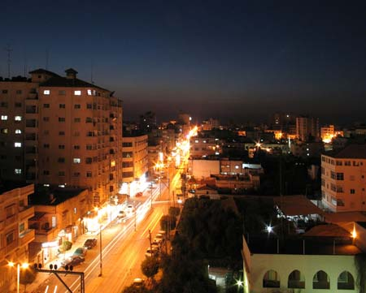
Notes:
Source: http://www.palestineremembered.com/GeoPoints/Gaza_526/Picture_53412.html, retrieved Nov. 12, 2010
Also on http://holyfalafel.com/tourism/gaza-palestine-travel-guide/
And http://www.skyscrapercity.com/showthread.php?t=1145941

Slide 2
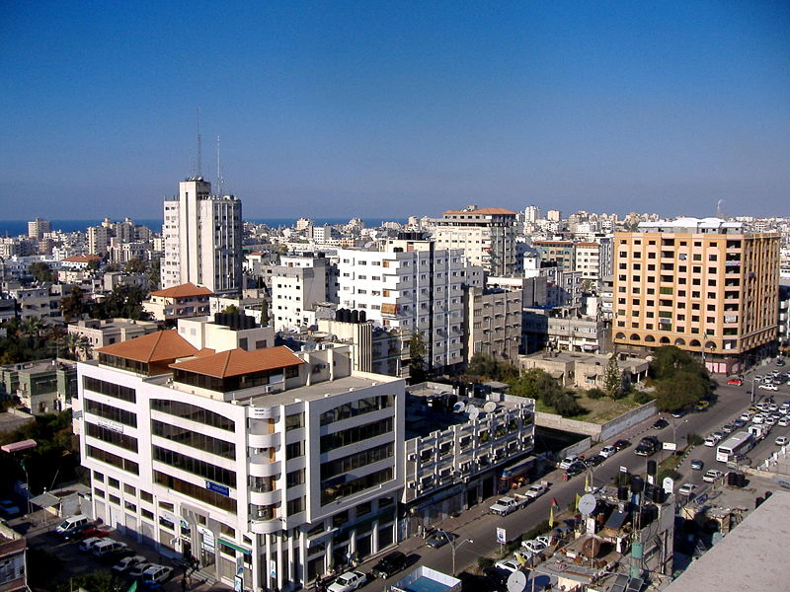
Notes:
Source: http://en.wikipedia.org/wiki/File:Gaza_City.JPG
Taken December 23, 2007; retrieved November 12, 2010

Slide 3
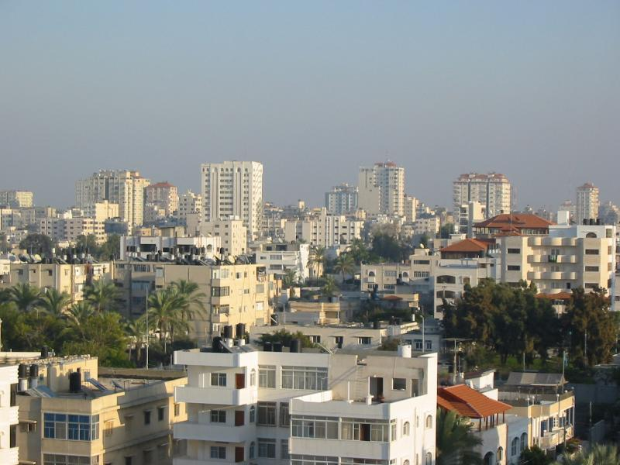
Notes:
Source: http://www.palestineremembered.com/GeoPoints/Gaza_526/Picture_11192.html, retrieved November 12, 2010

Slide 4
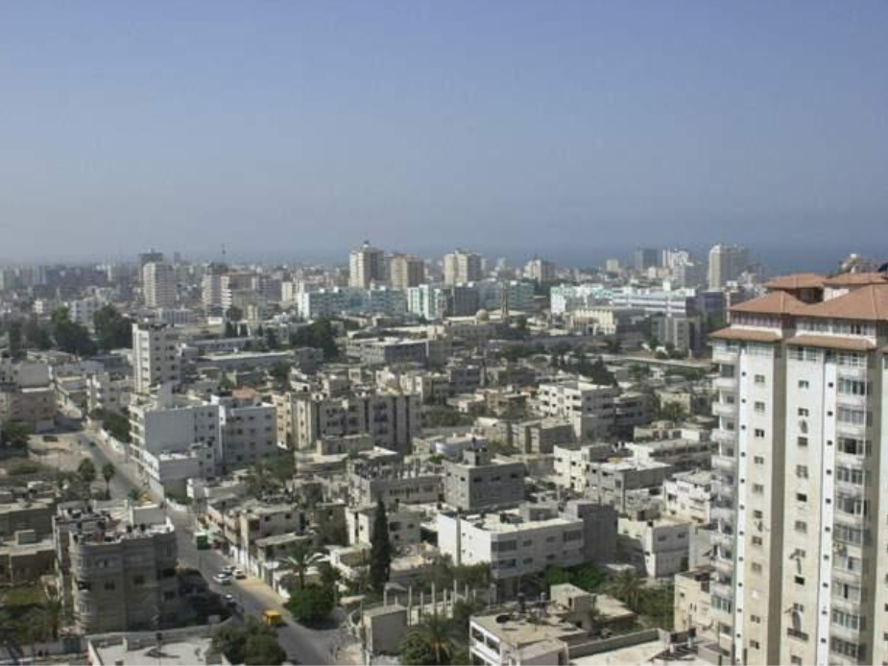
Notes:
Source: http://travel.webshots.com/photo/1087100700034143484WpUbRg, uploaded August 2003, retrieved November 12, 2010

Slide 5
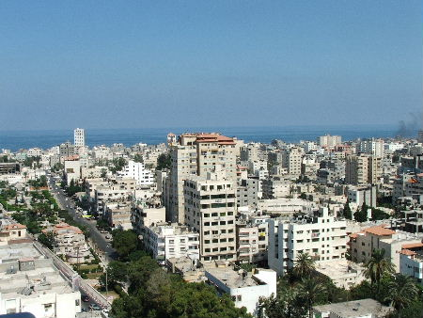
Notes:
Gaza City seen from the fourteenth floor of a downtown office building.
Source: Lisa Goldman, http://lisagoldman.net/2005/09/, September 2005, retrieved November 13, 2010

Slide 6
Notes:
Source: http://www.skyscrapercity.com/showthread.php?t=1145941, posted June 2010, retrieved November 13, 2010

Slide 7
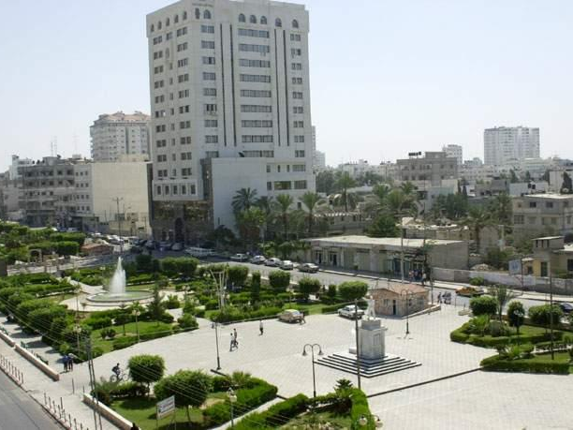
Notes:
Remal district in New Gaza Area, Unknown Soldier Square in front of the Legislative Council
Source: http://www.palestineremembered.com/GeoPoints/Gaza_526/Picture_11567.html, retrieved Nov. 12, 2010
Also at http://travel.webshots.com/photo/1087100631034143484SalAgO, uploaded August 2003
Close-up of the statute: http://www.palestineremembered.com/GeoPoints/Gaza_526/Picture_11566.html
And http://travel.webshots.com/photo/1087100353034143484bVwqFm, uploaded August 2003
More from the Remal district: http://www.urban-landscape.net/content_public/city_details.php?stadt_id=56

Slide 8
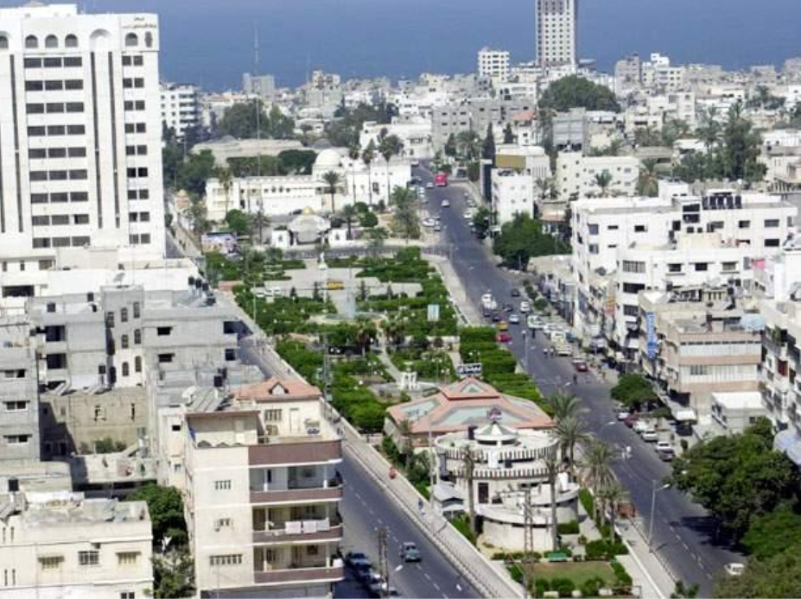
Notes:
Source: http://travel.webshots.com/photo/1087099995034143484SyXaee, uploaded August 2003, retrieved November 12, 2010
Also at http://www.palestineremembered.com/GeoPoints/Gaza_526/Picture_11562.html, uploaded January 2007

Slide 9
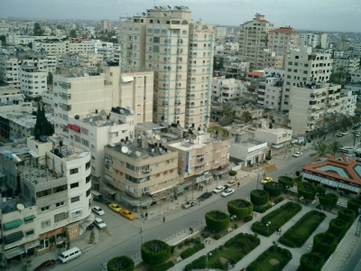
Notes:
Remal district in New Gaza Area
Source: http://www.urban-landscape.net/content_public/city_details.php?stadt_id=56, retrieved Nov. 12, 2010

Slide 10
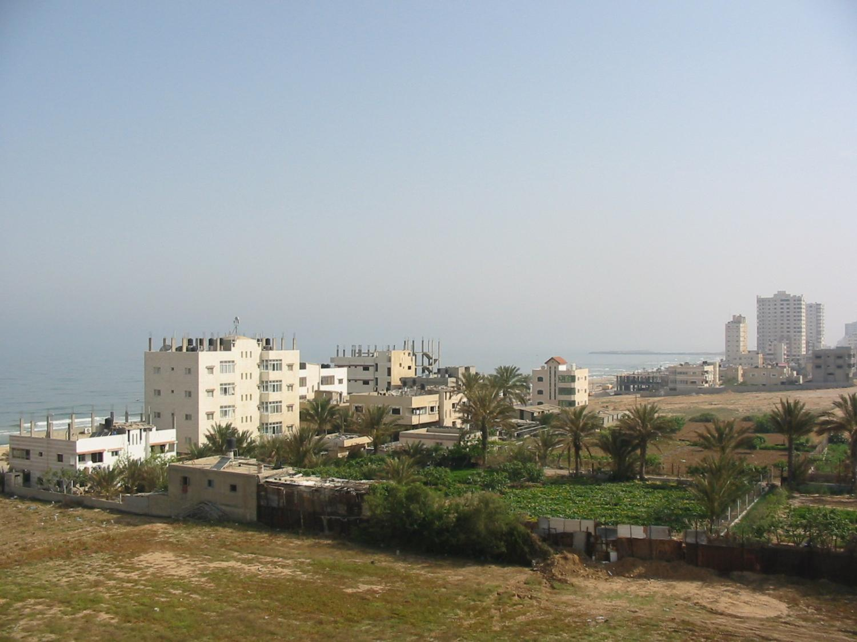
Notes:
Source: http://www.skyscrapercity.com/showthread.php?t=1145941, posted June 2010, retrieved November 13, 2010

Slide 11
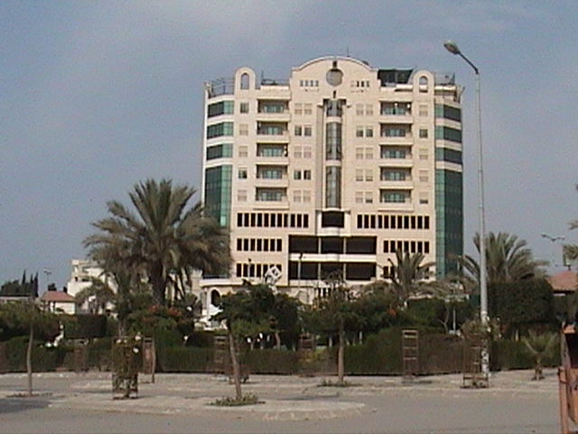
Notes:
Source: http://www.skyscrapercity.com/showthread.php?t=1145941, posted June 2010, retrieved November 13, 2010

Slide 12
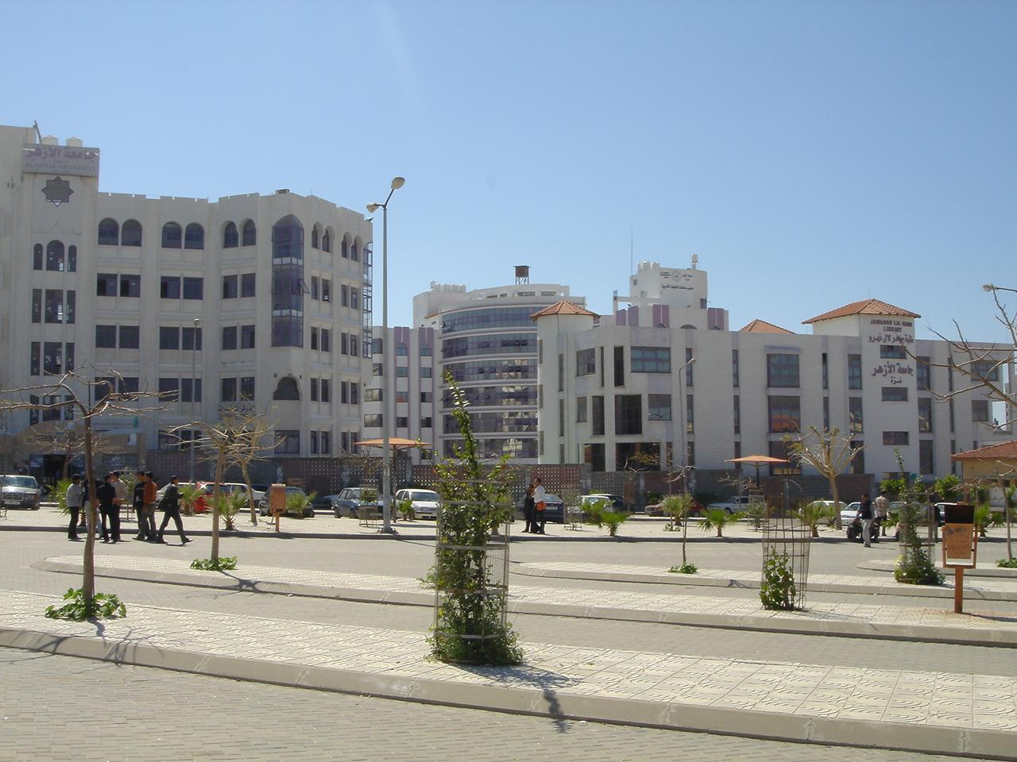
Notes:
Source: http://www.skyscrapercity.com/showthread.php?t=1145941, posted June 2010, retrieved November 13, 2010

Slide 13
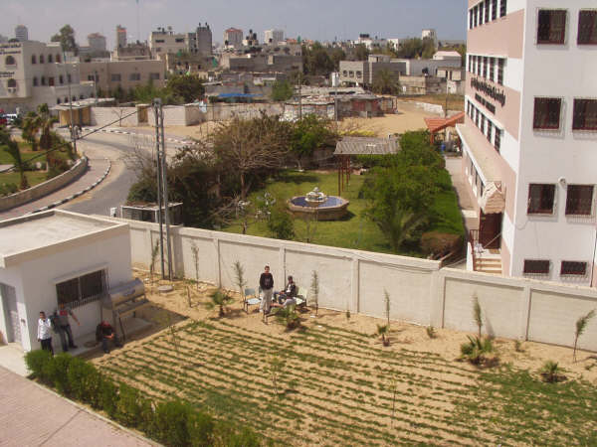
Notes:
Gaza City Source: http://www.palestineremembered.com/GeoPoints/Gaza_526/Picture_12698.html, retrieved November 13, 2010

Slide 14
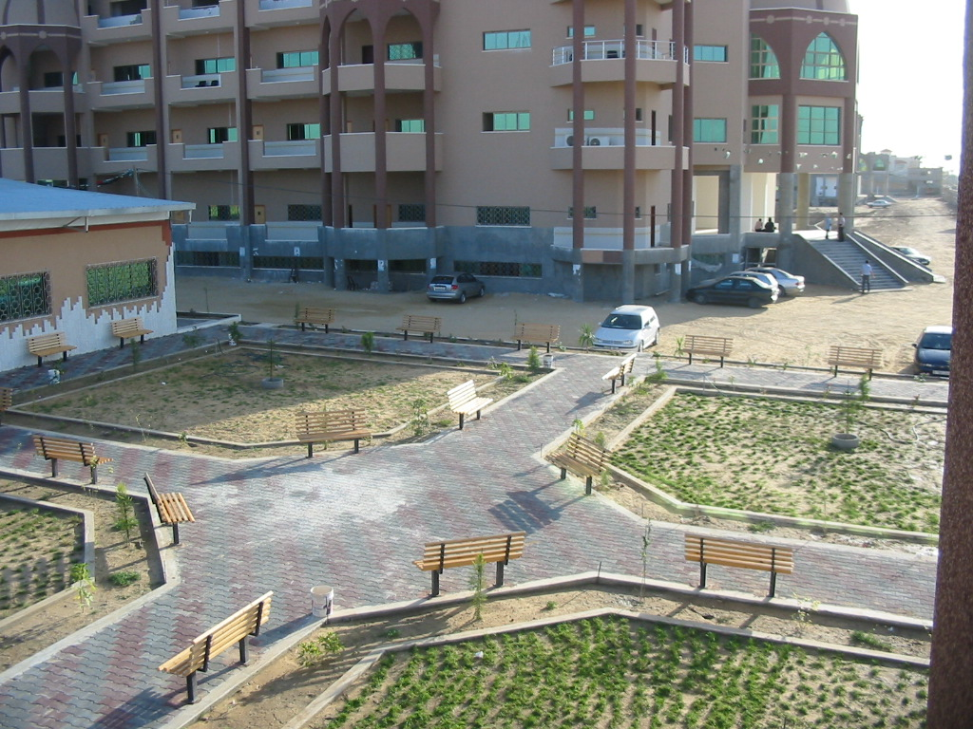
Notes:
Source: http://www.palestineremembered.com/GeoPoints/Gaza_526/Picture_44177.html, retrieved November 13, 2010

Slide 15
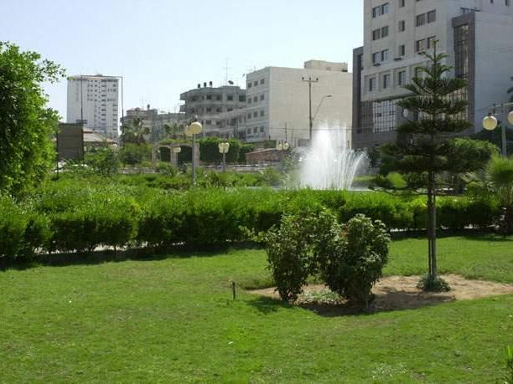
Notes:
Unknown soldier / al-Jundi al-Majhoul park Source: http://www.palestineremembered.com/GeoPoints/Gaza_526/Picture_11565.html, retrieved Nov. 12, 2010
Also at http://travel.webshots.com/photo/1087100263034143484iJRcGu, posted August 2003

Slide 16
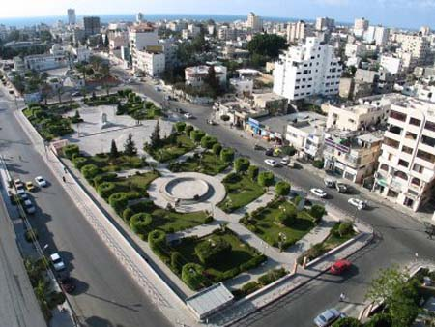
Notes:
Source: http://www.palestineremembered.com/GeoPoints/Gaza_526/Picture_53410.html, retrieved November 12, 2010

Slide 17
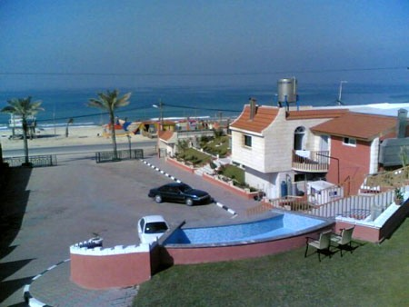
Notes:
Source: http://www.skyscrapercity.com/showthread.php?t=1145941, posted June 2010, retrieved November 13, 2010

Slide 18
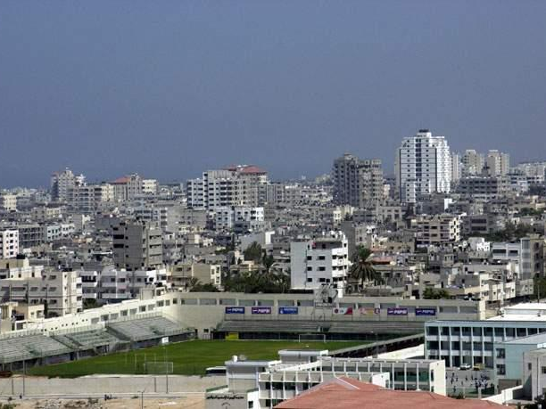
Notes:
Palestine Stadium
Source: http://www.palestineremembered.com/GeoPoints/Gaza_526/Picture_11563.html, retrieved November 12, 2010
Also at http://travel.webshots.com/photo/1087100088034143484cyNBRX, posted August 2003

Slide 19
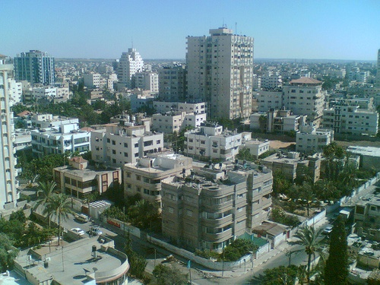
Notes:
Source: http://www.skyscrapercity.com/showthread.php?t=1145941, posted June 2010, retrieved November 13, 2010

Slide 20
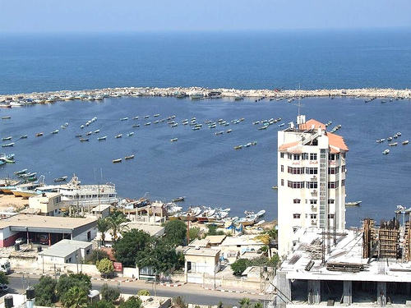
Notes:
Source: http://www.skyscrapercity.com/showthread.php?t=1145941, posted June 2010, retrieved November 13, 2010

Slide 21
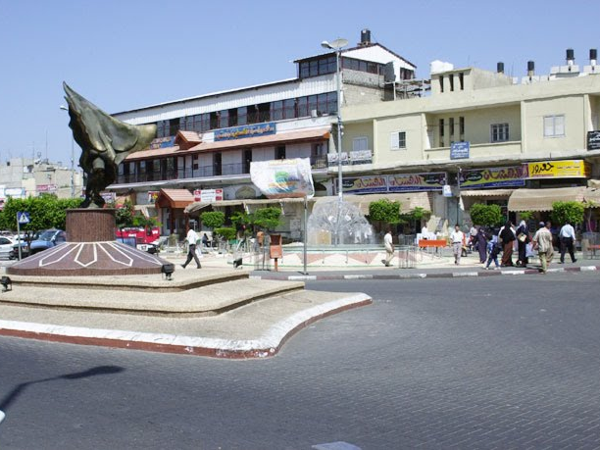
Notes:
Source: http://www.skyscrapercity.com/showthread.php?t=1145941, posted June 2010, retrieved November 13, 2010

Slide 22
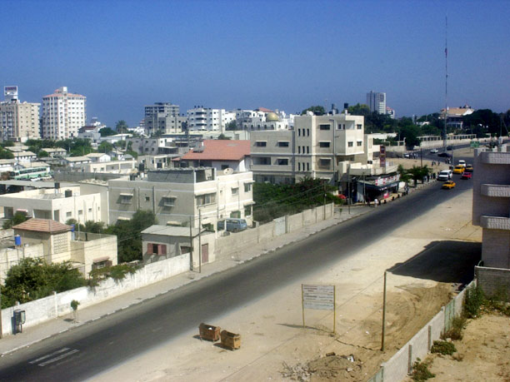
Notes:
Source: http://www.skyscrapercity.com/showthread.php?t=1145941, posted June 2010, retrieved November 13, 2010

Slide 23
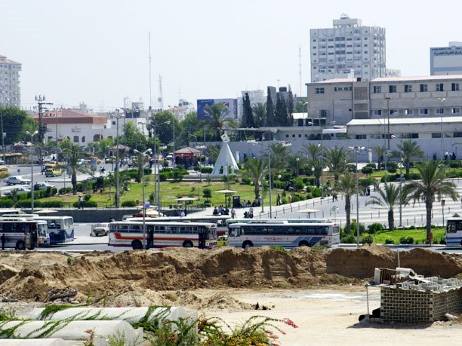
Notes:
Source: http://www.skyscrapercity.com/showthread.php?t=1145941, posted June 2010, retrieved November 13, 2010

Slide 24
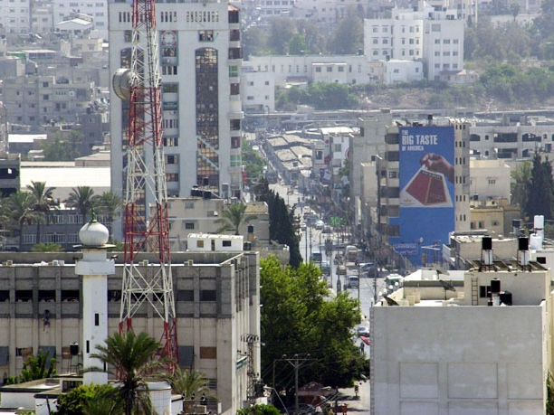
Notes:
Source: http://www.skyscrapercity.com/showthread.php?t=1145941, posted June 2010, retrieved November 13, 2010

Slide 25
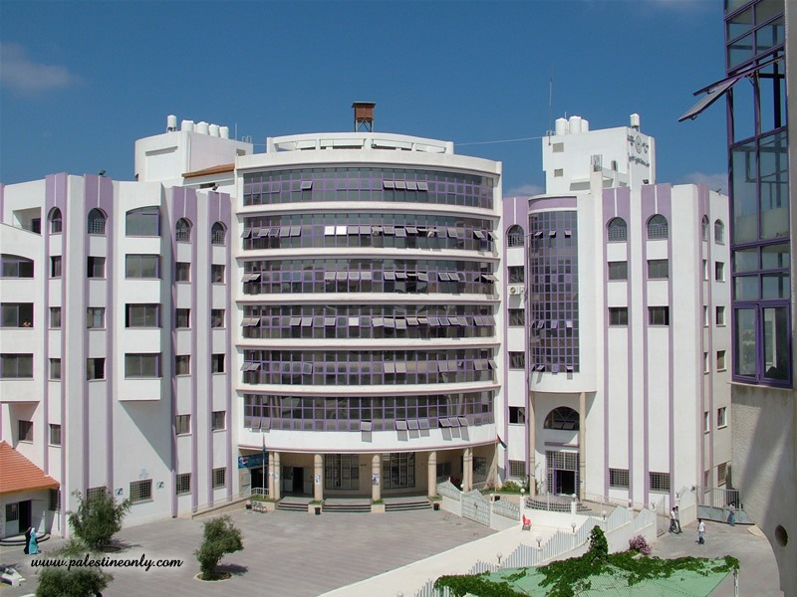
Notes:
Source: http://www.skyscrapercity.com/showthread.php?t=1145941, posted June 2010, retrieved November 13, 2010

Slide 26
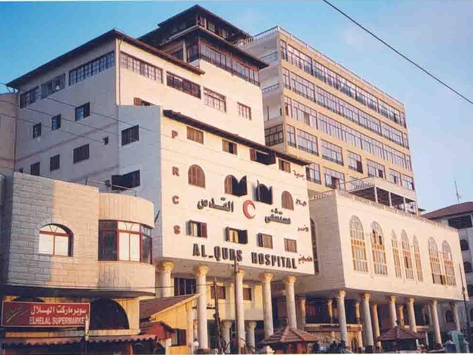
Notes:
Al Quds Hospital
Source: http://www.skyscrapercity.com/showthread.php?t=1145941, posted June 2010, retrieved November 13, 2010

Slide 27
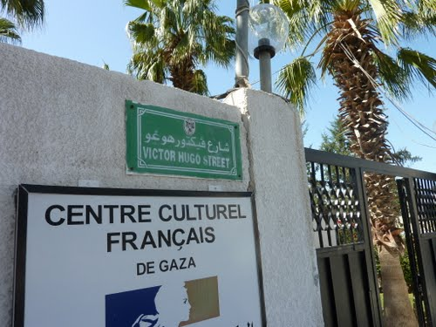
Notes:
Al Quds Hospital
Source: http://www.skyscrapercity.com/showthread.php?t=1145941, posted June 2010, retrieved November 13, 2010

Slide 28
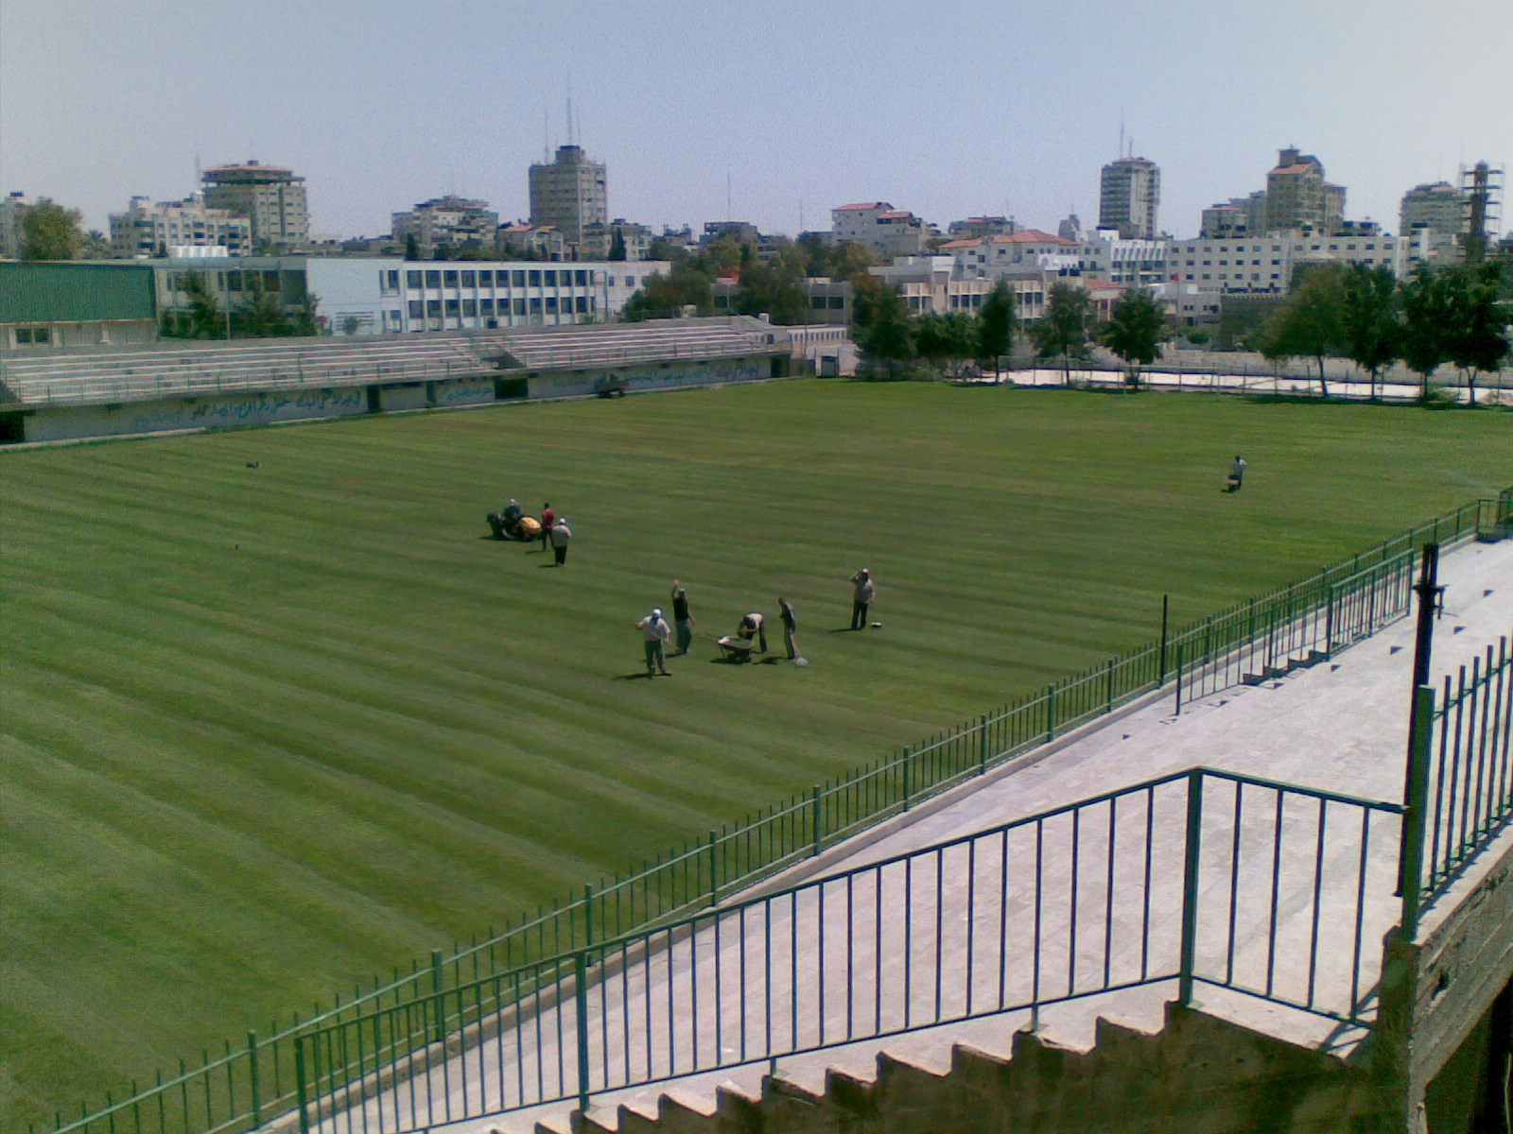
Notes:
Palestine Stadium
Source: http://www.palestineremembered.com/GeoPoints/Gaza_526/Picture_40660.html, retrieved November 12, 2010

Slide 29
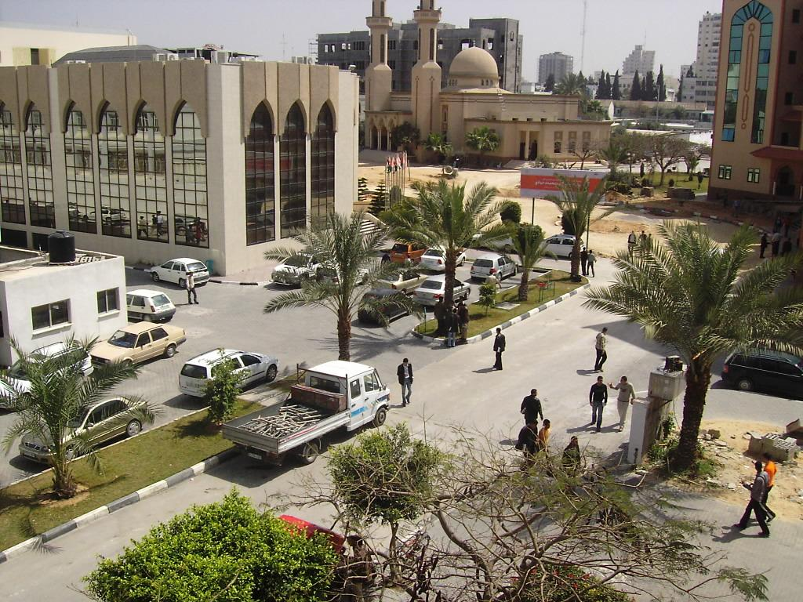
Notes:
Islamic University of Gaza
Source: http://www.palestineremembered.com/GeoPoints/Gaza_526/Picture_18110.html, retrieved November 12, 2010

Slide 30
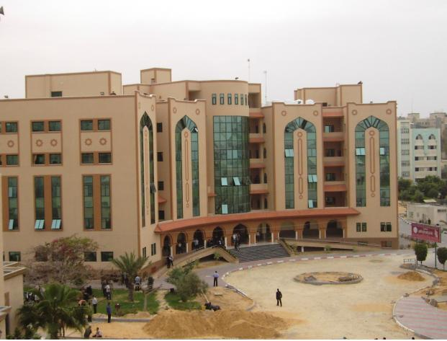
Notes:
Islamic University of Gaza
Source: http://www.palestineremembered.com/GeoPoints/Gaza_526/Picture_17367.html, retrieved November 12, 2010

Slide 31
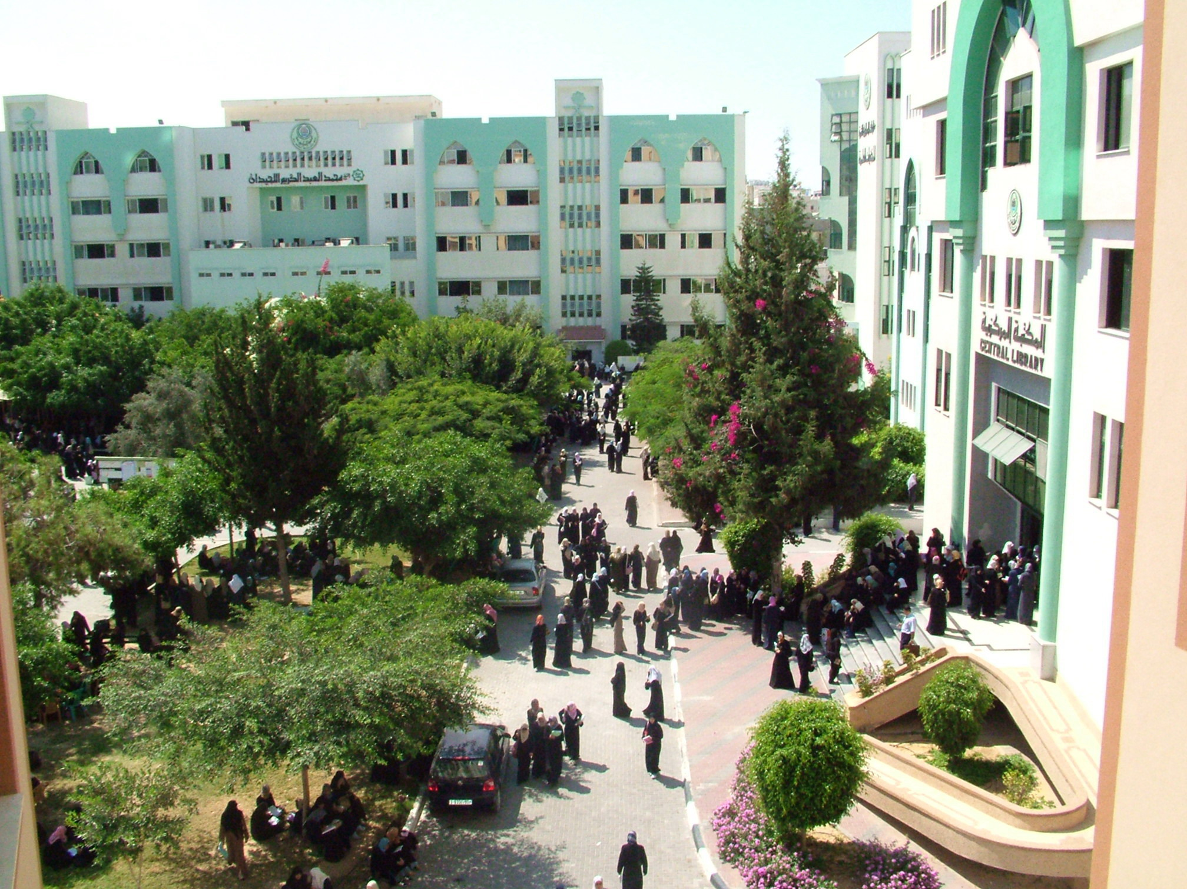
Notes:
Islamic University
Source: http://www.panoramio.com/photo/10567702, retrieved November 12, 2010

Slide 32
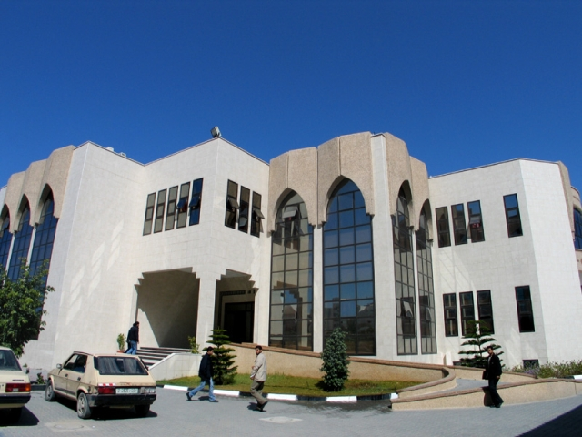
Notes:
Islamic University, Main Conference Hall before its destruction in the conflict between Hamas and Fatah in 2007.
Source: http://en.wikipedia.org/wiki/File:Conference_hall_iug.jpg, retrieved November 12, 2010

Slide 33
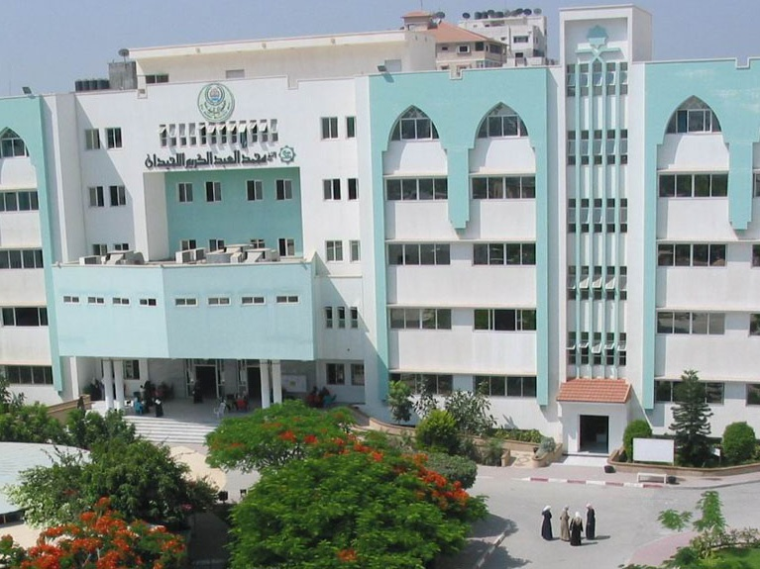
Notes:
Islamic University, Luhidan Students Building
Source: http://www.panoramio.com/photo/11226816, retrieved November 12, 2010

Slide 34
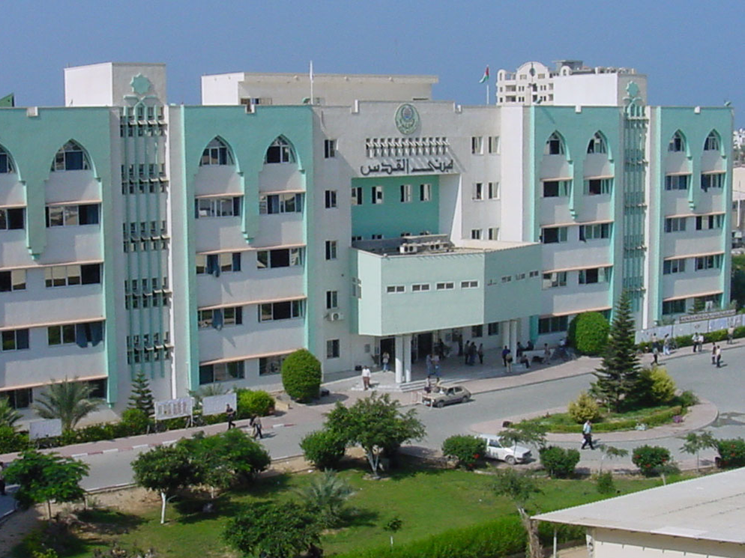
Notes:
Islamic University, Luhidan (or Al Quds?) Student Building
Source: http://www.panoramio.com/photo/11226777, retrieved November 12, 2010

Slide 35
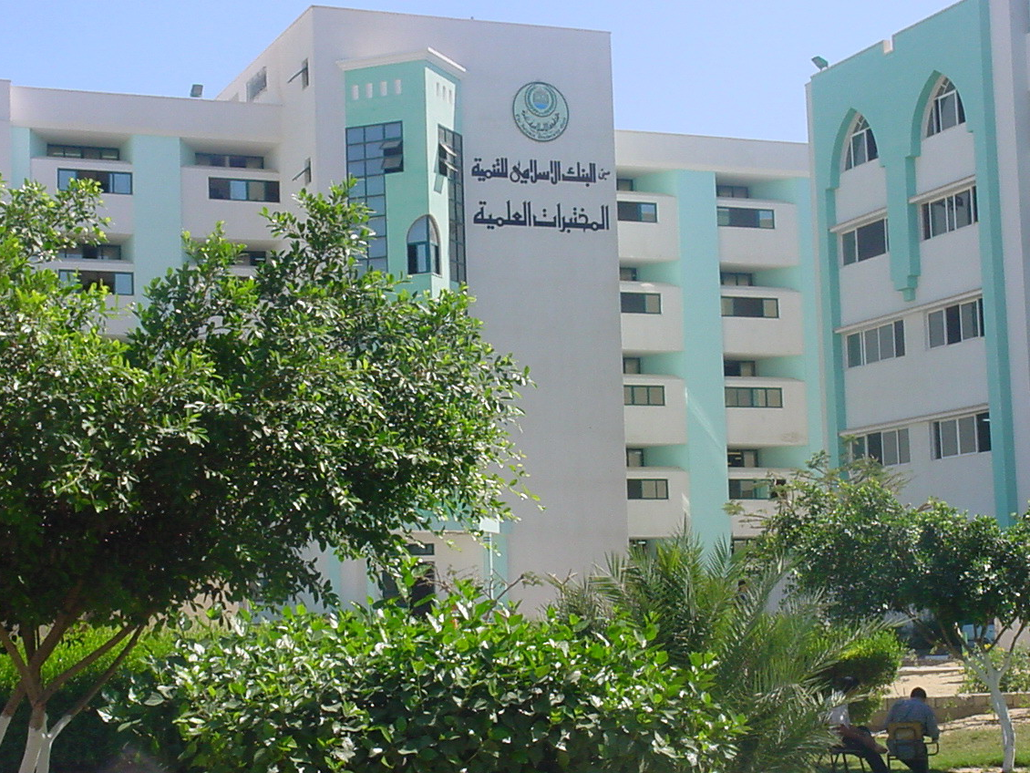
Notes:
Islamic University, Laboratories Building
Source: http://www.panoramio.com/photo/10567709, retrieved November 12, 2010

Slide 36
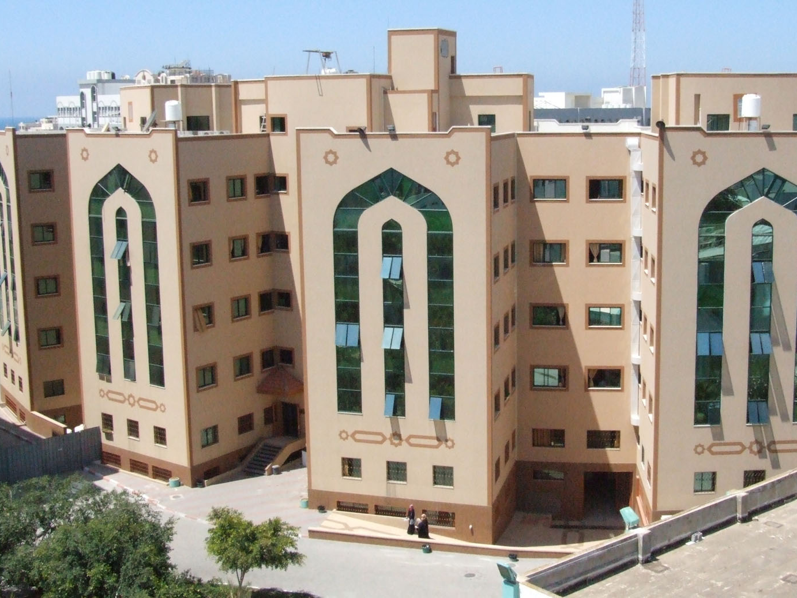
Notes:
Islamic University, Management Building
Source: http://www.panoramio.com/photo/11226827, retrieved November 12, 2010

Slide 37
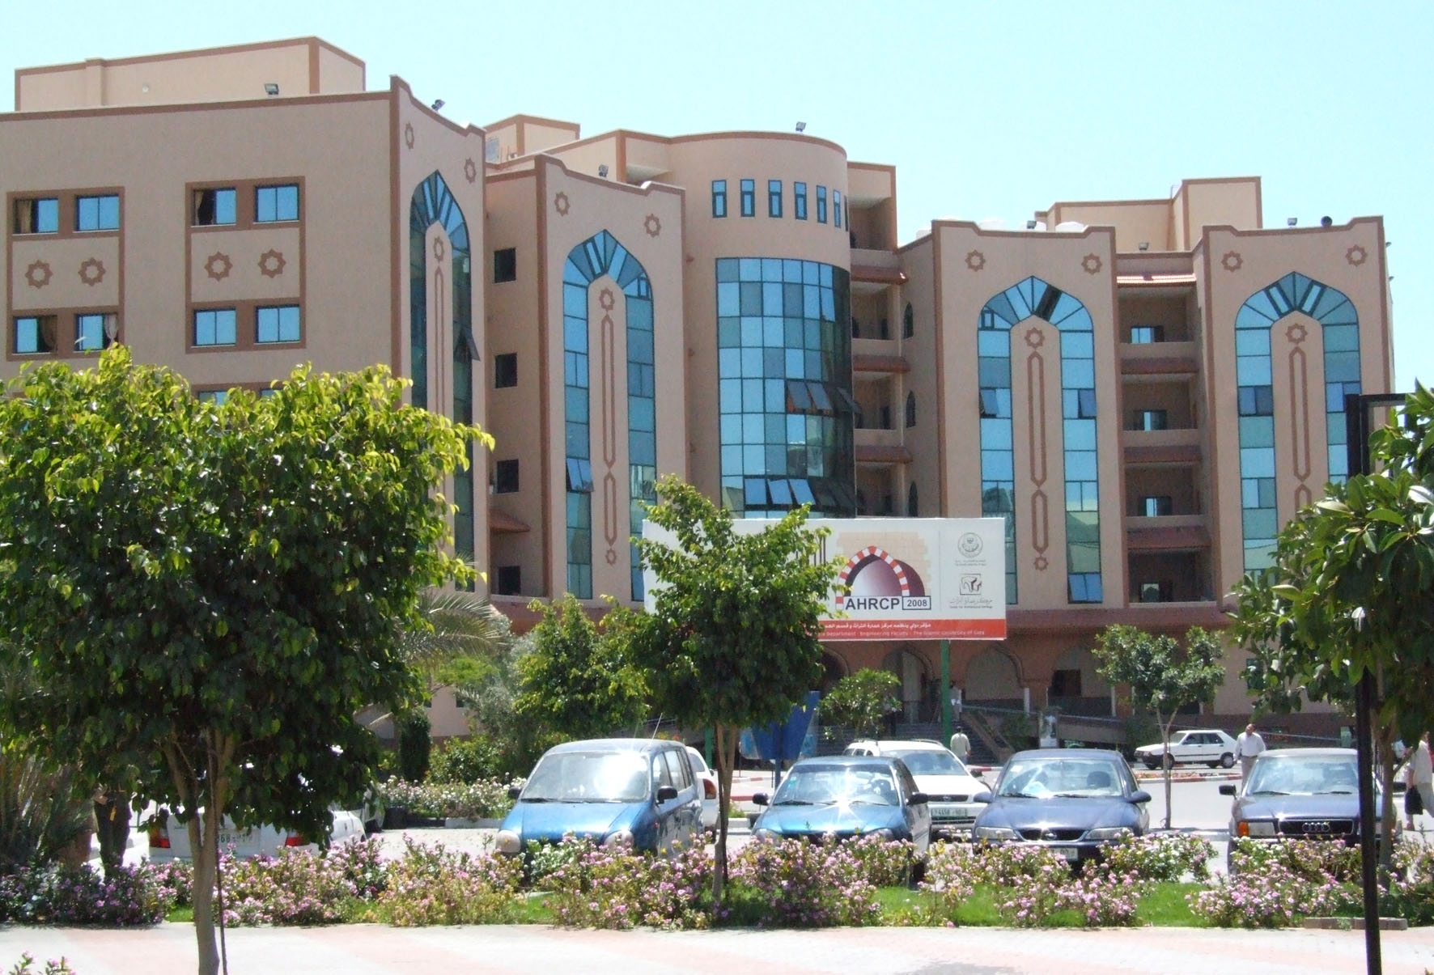
Notes:
Islamic University, Management Building
Source: http://www.panoramio.com/photo/11226841, retrieved November 12, 2010

Slide 38
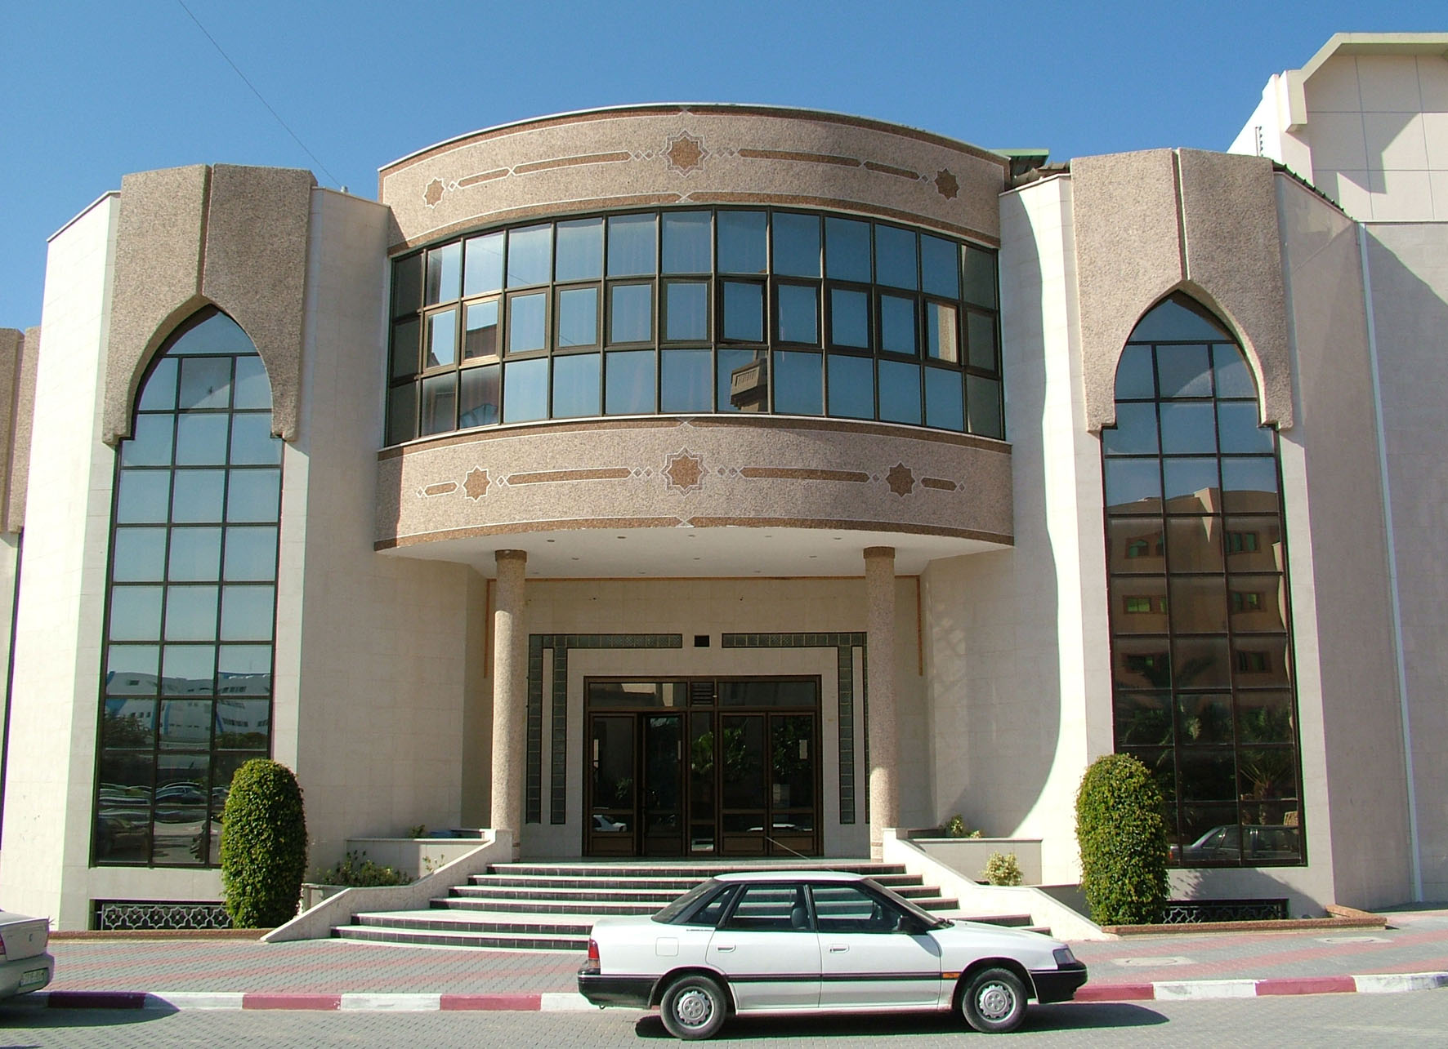
Notes:
Islamic University, Conference Building
Source: http://www.panoramio.com/photo/11226803, retrieved November 12, 2010

Slide 39
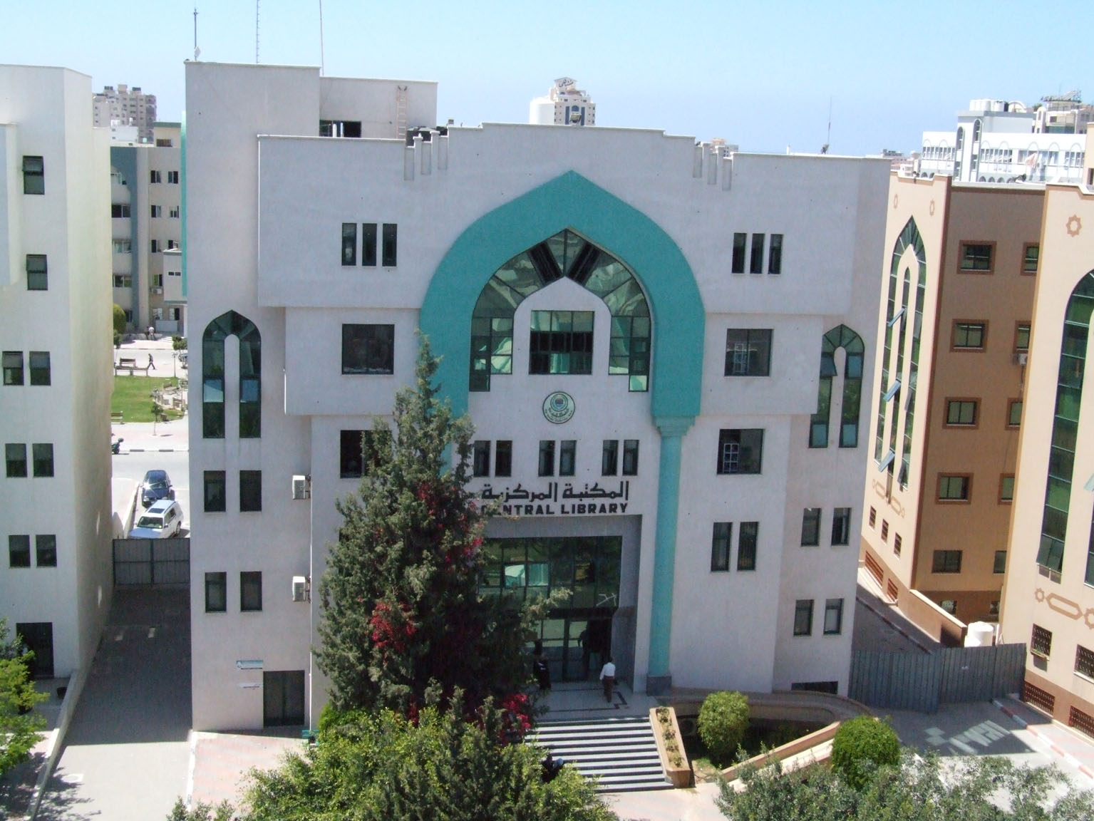
Notes:
Islamic University, Central Library
Source: http://www.panoramio.com/photo/11226790, retrieved November 12, 2010

Slide 40
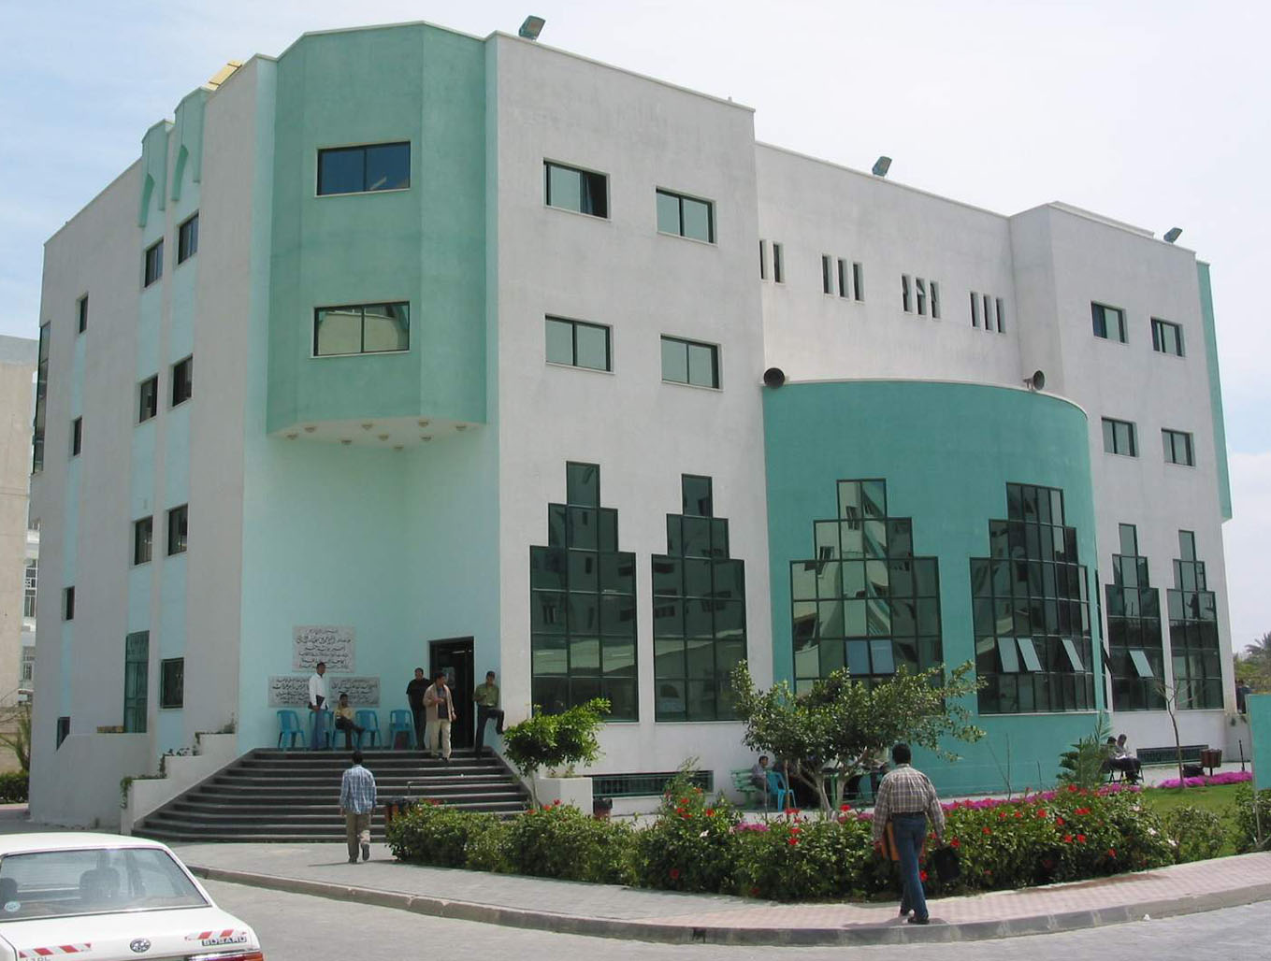
Notes:
Islamic University, Student Activity Building
Source: http://www.panoramio.com/photo/11226866, retrieved November 12, 2010

Slide 41
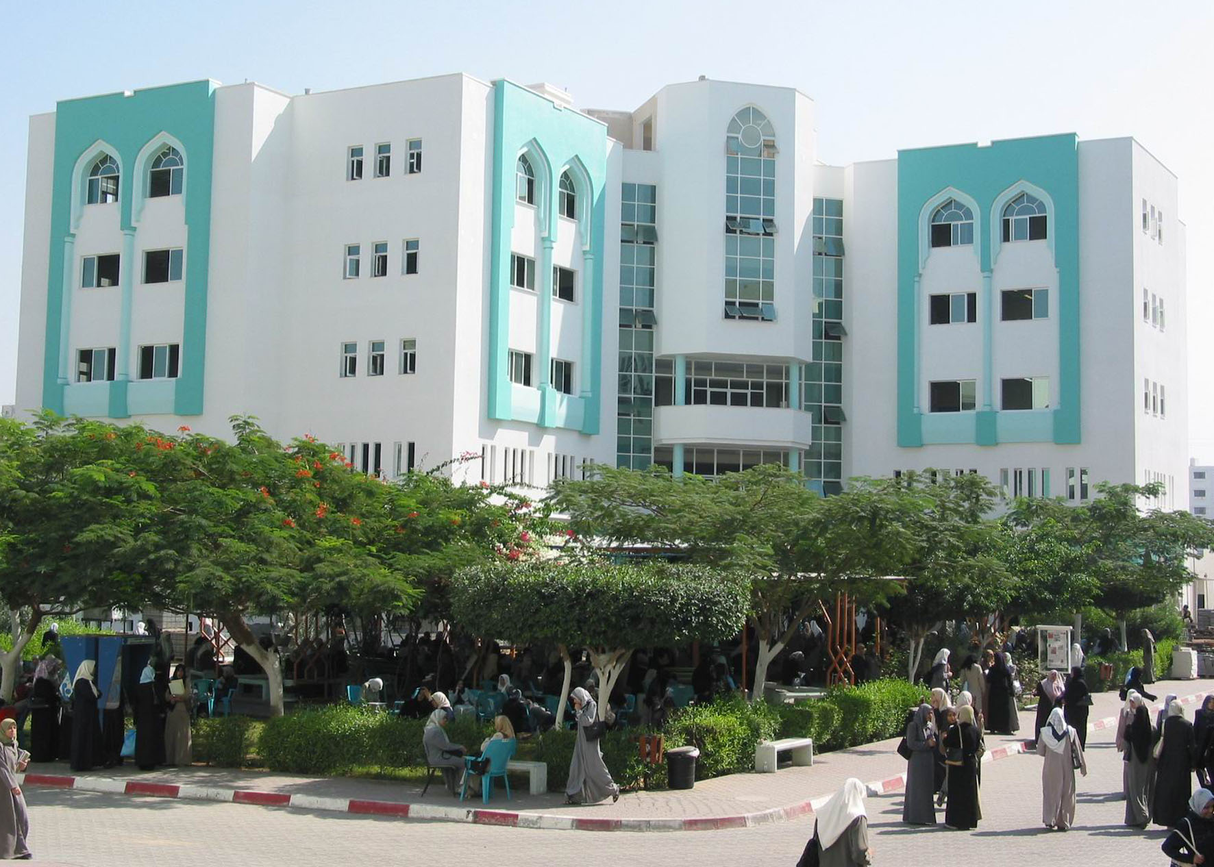
Notes:
Islamic University, Almadina Almonawara Students Building
Source: http://www.panoramio.com/photo/11226756, retrieved November 12, 2010

Slide 42
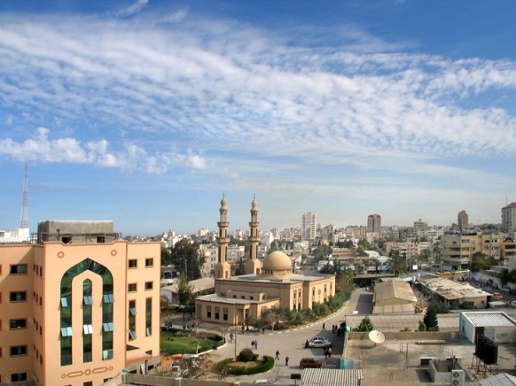
Notes:
The mosque of the Islamic University of Gaza
Source: http://en.wikipedia.org/wiki/File:Mosque_conf_hall_iug.jpg
Taken January 13, 2009; retrieved November 12, 2010

Slide 43
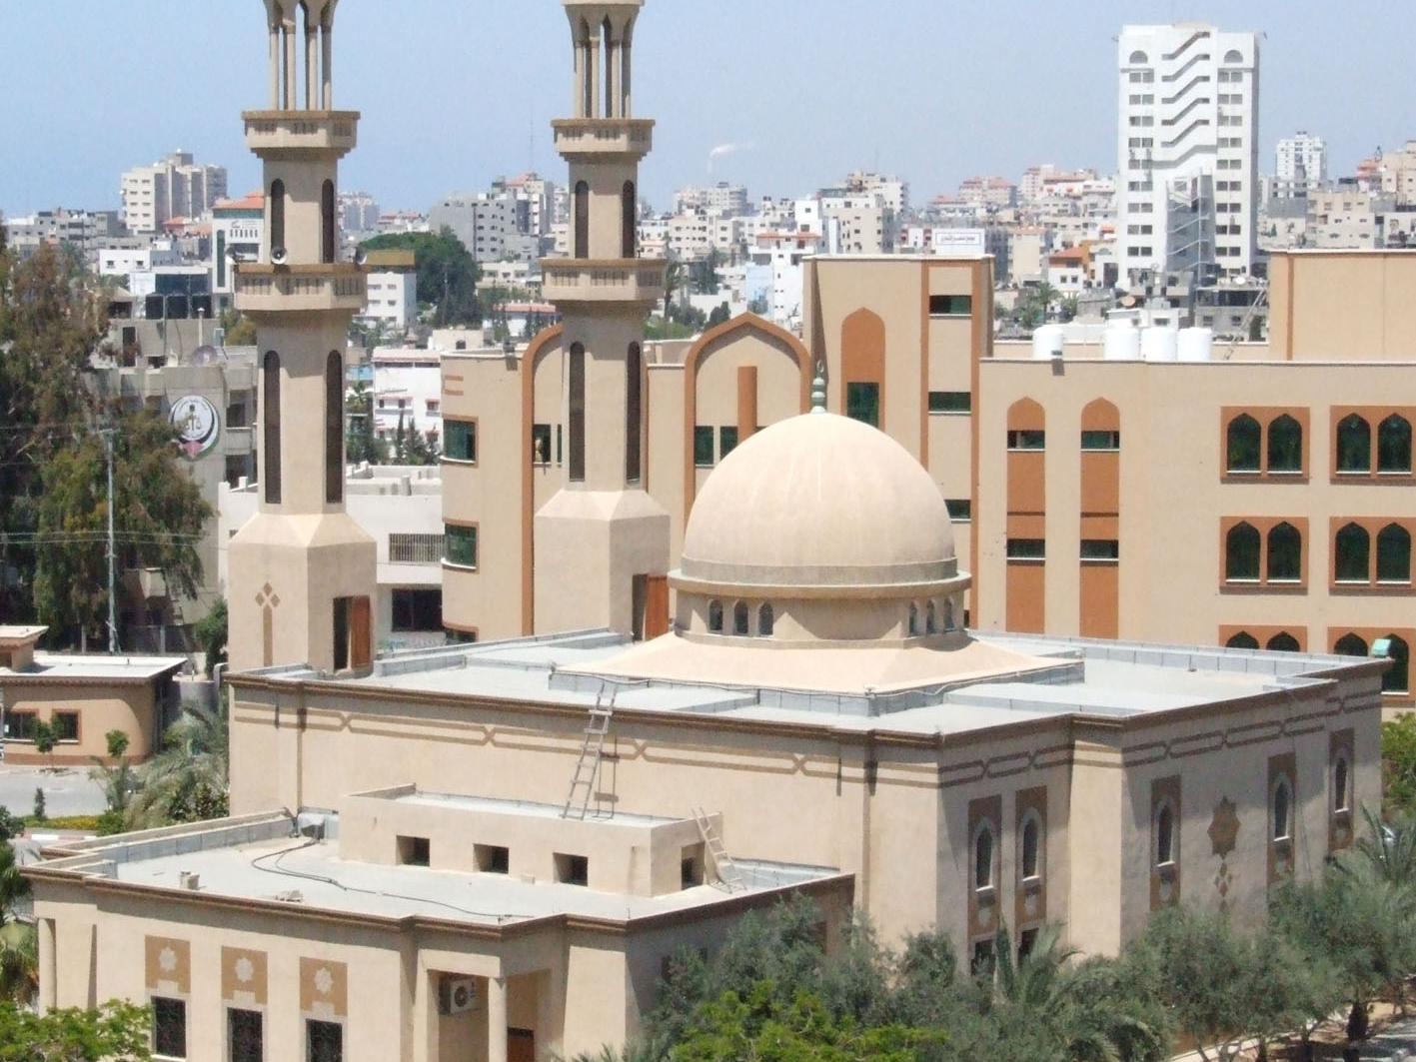
Notes:
Islamic University of Gaza Mosque
Source: http://www.panoramio.com/photo/11226862, retrieved November 12, 2010

Slide 44
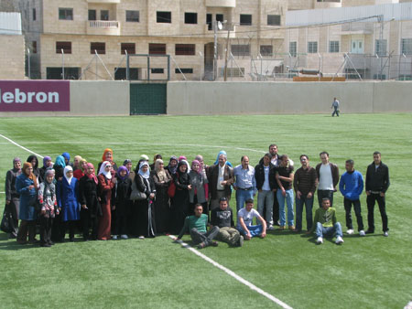
Notes:
Al Quds Open University, Gaza
Source: http://www.qou.edu/photoAlbum2010/index.jsp, retrieved November 13, 2010

Slide 45
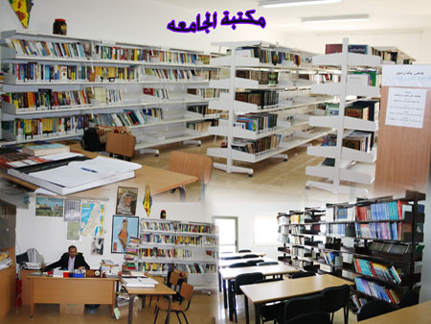
Notes:
Al Quds Open University, Gaza
Source: http://www.qou.edu/photoAlbum2010/index.jsp, retrieved November 13, 2010 (note maps of “Palestine”)

Slide 46
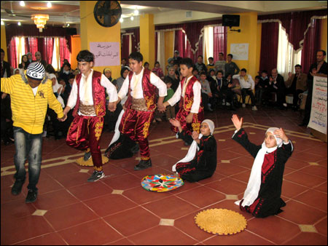
Notes:
Al Quds Open University, Gaza
Source: http://www.qou.edu/photoAlbum2010/index.jsp, retrieved November 13, 2010

Slide 47
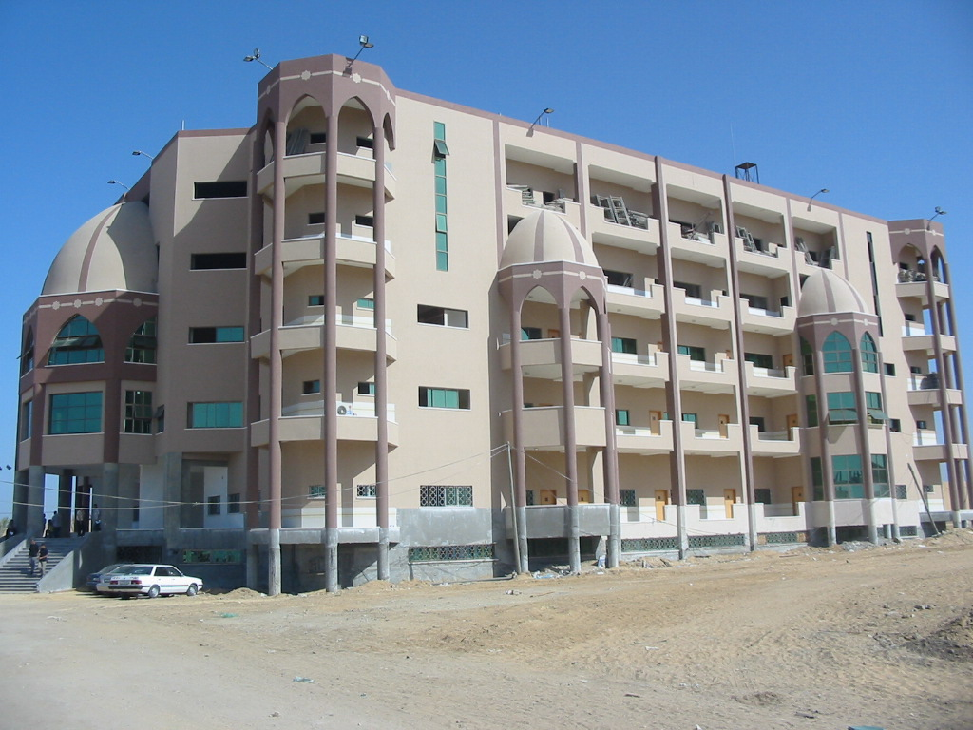
Notes:
University of Palestine (built on the site of the Israeli settlement Netzarim, evacuated in 2005)
Source: http://www.palestineremembered.com/GeoPoints/Gaza_526/Picture_44176.html, retrieved November 12, 2010

Slide 48
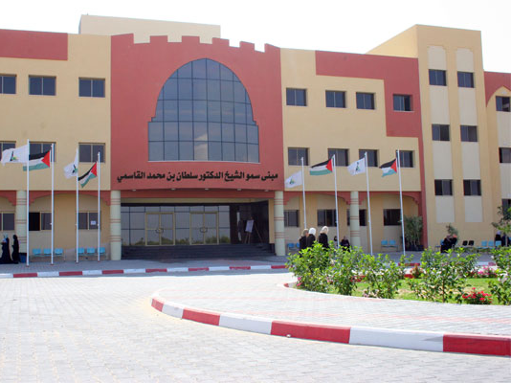
Notes:
Al-Aqsa University
Source: http://www.palestineremembered.com/GeoPoints/Gaza_526/Picture_38224.html, retrieved November 12, 2010

Slide 49
Notes:
Al-Azhar University Source: http://www.palestineremembered.com/GeoPoints/Gaza_526/Picture_11201.html, retrieved November 12, 2010

Slide 50
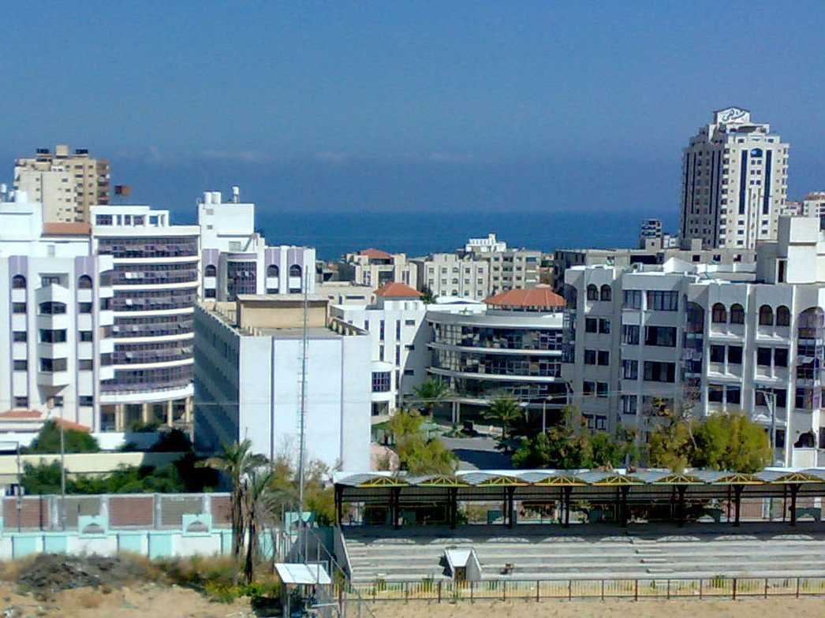
Notes:
Al-Azhar University Source: http://www.panoramio.com/photo/11226747, retrieved November 12, 2010

Slide 51
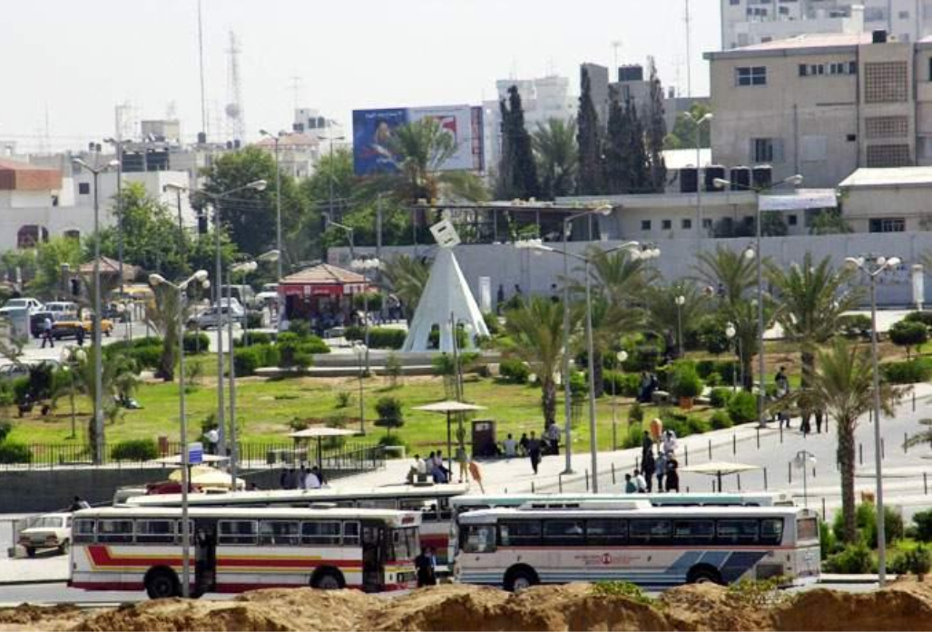
Notes:
Al-Azhar University Garden
Source: http://travel.webshots.com/photo/1087100864034143484SCjWZg, uploaded August 2003, retrieved November 12, 2010

Slide 52
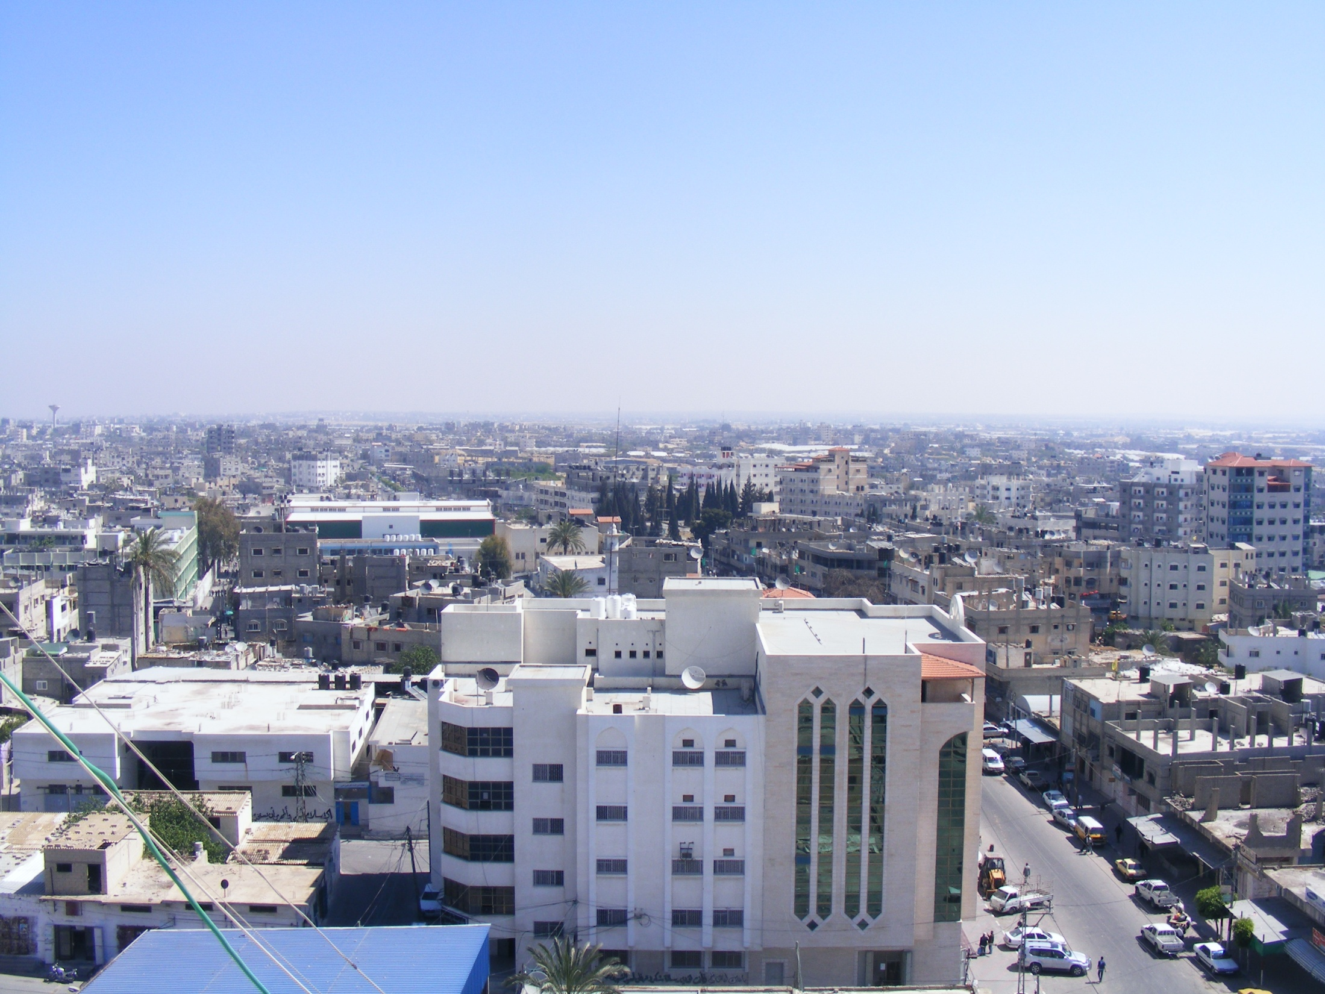
Notes:
Rafah Municipality Source: http://www.panoramio.com/photo/9680199, retrieved November 12, 2010

Slide 53
Notes:
Gaza from the Sea Source: http://www.panoramio.com/photo/10302116, retrieved November 12, 2010

Slide 54
Notes:
General view from the sea looking east Source: http://www.palestineremembered.com/GeoPoints/Gaza_526/Picture_11190.html, retrieved November 12, 2010

Slide 55
Notes:
El-Helou Hotel
Source: http://www.palestineremembered.com/GeoPoints/Gaza_526/Picture_46835.html, retrieved November 12, 2010

Slide 56
Notes:
Grand Palace Hotel
Source: http://www.facebook.com/photo.php?pid=2645256&id=155278996729, retrieved November 12, 2010

Slide 57
Notes:
Commodore Hotel, Gaza, July 2010
Source: http://www.israellycool.com/2010/07/22/a-taste-of-%E2%80%9Cconcentration-camp%E2%80%9D-gaza-the-commodore-hotel/

Slide 58
Notes:
Grand Palace Hotel
Source: http://www.facebook.com/photo.php?pid=2679836&id=155278996729, retrieved November 12, 2010

Slide 59
Notes:
Grand Palace Hotel Lobby
Source: http://www.facebook.com/photo.php?pid=2645258&id=155278996729&fbid=155317746729, retrieved November 12, 2010

Slide 60
Notes:
Grand Palace Hotel Lobby
Source: http://www.grandpalace.ps/, retrieved November 12, 2010

Slide 61
Notes:
Grand Palace Hotel Restaurant
Source: http://www.grandpalace.ps/, retrieved November 12, 2010

Slide 62
Notes:
Adam Hotel
Source: http://www.adamhotelgaza.com/gallery.html, retrieved November 12, 2010

Slide 63
Notes:
Adam Hotel
Source: http://www.adamhotelgaza.com/gallery.html, retrieved November 12, 2010

Slide 64
Notes:
Adam Hotel
Source: http://www.adamhotelgaza.com/gallery.html, retrieved November 12, 2010

Slide 65
Notes:
Adam Hotel
Source: http://www.adamhotelgaza.com/gallery.html, retrieved November 12, 2010

Slide 66
Notes:
Adam Hotel
Source: http://www.adamhotelgaza.com/gallery.html, retrieved November 12, 2010

Slide 67
Notes:
Al Deira Hotel, Gaza
Source: http://www.aldeira.ps/. Retrieved November 13, 2010

Slide 68
Notes:
View from the Beach Hotel, taken August 2003, uploaded January 2007
Source: http://www.palestineremembered.com/GeoPoints/Gaza_526/Picture_11245.html, retrieved November 12, 2010

Slide 69
Notes:
The Harbor, taken August 2003, uploaded January 2007
Source: http://www.palestineremembered.com/GeoPoints/Gaza_526/Picture_11232.html, retrieved November 12, 2010

Slide 70
Notes:
Source: My Daily Clarity, “The most exclusive surf club on earth?”
http://mydailyclarity.com/2009/05/the-smallest-surf-club-on-earth/. Retrieved November 13, 2010.

Slide 71
Notes:
Source: http://en.wikipedia.org/wiki/File:Gaza_Beach.jpg
Taken July 1, 2006; retrieved November 12, 2010

Slide 72
Notes:
Source: One Jerusalem, http://www.onejerusalem.com/2010/08/24/gaza-2010/gaza2010-13/, retrieved November 13, 2010

Slide 73
Notes:
Source: http://www.skyscrapercity.com/showthread.php?t=1145941, posted June 2010, retrieved November 13, 2010

Slide 74
Notes:
Source: http://www.skyscrapercity.com/showthread.php?t=1145941, posted June 2010, retrieved November 13, 2010

Slide 75
Notes:
Source: http://www.skyscrapercity.com/showthread.php?t=1145941, posted June 2010, retrieved November 13, 2010

Slide 76
Notes:
Source: http://www.skyscrapercity.com/showthread.php?t=1145941, posted June 2010, retrieved November 13, 2010

Slide 77
Notes:
Source: http://www.skyscrapercity.com/showthread.php?t=1145941, posted June 2010, retrieved November 13, 2010

Slide 78
Notes:
Source: http://www.skyscrapercity.com/showthread.php?t=1145941, posted June 2010, retrieved November 13, 2010

Slide 79
Notes:
Source: http://www.skyscrapercity.com/showthread.php?t=1145941, posted June 2010, retrieved November 13, 2010

Slide 80
Notes:
Source: http://www.skyscrapercity.com/showthread.php?t=1145941, posted June 2010, retrieved November 13, 2010

Slide 81
Notes:
Gaza Surf Club
Source: http://www.gazasurfclub.com/Photos/Photos.html, retrieved November 13, 2010

Slide 82
Notes:
Gaza Surf Club
Source: http://www.gazasurfclub.com/Photos/Photos.html, retrieved November 13, 2010

Slide 83
Notes:
Gaza Surf Club
Source: http://www.gazasurfclub.com/Photos/Photos.html, retrieved November 13, 2010

Slide 84
Notes:
Source: http://www.skyscrapercity.com/showthread.php?t=1145941, posted June 2010, retrieved November 13, 2010

Slide 85
Notes:
Source: http://www.skyscrapercity.com/showthread.php?t=1145941, posted June 2010, retrieved November 13, 2010

Slide 86
Notes:
Source: The Palestine Telegraph, April 6, 2009, retrieved November 13, 2010
http://www.paltelegraph.com/index.php?option=com_content&view=article&id=480&Itemid=182

Slide 87
Notes:
Source: http://www.skyscrapercity.com/showthread.php?t=1145941, posted June 2010, retrieved November 13, 2010

Slide 88
Notes:
Source: http://www.skyscrapercity.com/showthread.php?t=1145941, posted June 2010, retrieved November 13, 2010

Slide 89
Notes:
Source: http://www.skyscrapercity.com/showthread.php?t=1145941, posted June 2010, retrieved November 13, 2010

Slide 90
Notes:
Palestinian fishing boats are seen at sunset in Gaza City on June 11, 2009. (UPI Photo/Ismael Mohamad)
Source: http://www.upi.com/News_Photos/view/853a15c0ebc6890f981301f883ad668f/Palestinians-enjoy-beach-in-Gaza/, retrieved November 13, 2010

Slide 91
Notes:
Source: http://www.skyscrapercity.com/showthread.php?t=1145941, posted June 2010, retrieved November 13, 2010

Slide 92
Notes:
Source: http://www.palestineremembered.com/GeoPoints/Gaza_526/Picture_40659.html, retrieved November 13, 2010

Slide 93
Notes:
Gaza Mall, July 17, 2010
Source: http://www.alresalahtalk.net/vb/showthread.php?t=3636, retrieved November 12, 2010
As reported by Tom Gross Media, http://www.tomgrossmedia.com/mideastdispatches/archives/001127.html

Slide 94
Notes:
Gaza Mall, July 17, 2010
Source: http://www.alresalahtalk.net/vb/showthread.php?t=3636, retrieved November 12, 2010
As reported by Tom Gross Media, http://www.tomgrossmedia.com/mideastdispatches/archives/001127.html

Slide 95
Notes:
Gaza Mall, July 17, 2010
Source: http://www.alresalahtalk.net/vb/showthread.php?t=3636, retrieved November 12, 2010
As reported by Tom Gross Media, http://www.tomgrossmedia.com/mideastdispatches/archives/001127.html

Slide 96
Notes:
Gaza Mall, July 17, 2010
Source: http://www.paltimes.net/arabic/read.php?news_id=115527, retrieved November 12, 2010
As reported by Tom Gross Media, http://www.tomgrossmedia.com/mideastdispatches/archives/001127.html

Slide 97
Notes:
Gaza Mall, July 17, 2010
Source: http://www.alresalahtalk.net/vb/showthread.php?t=3636, retrieved November 12, 2010
As reported by Tom Gross Media, http://www.tomgrossmedia.com/mideastdispatches/archives/001127.html

Slide 98
Notes:
Gaza Mall, July 17, 2010
Source: http://www.alresalahtalk.net/vb/showthread.php?t=3636, retrieved November 12, 2010
As reported by Tom Gross Media, http://www.tomgrossmedia.com/mideastdispatches/archives/001127.html

Slide 99
Notes:
Gaza Mall, July 17, 2010
Source: http://www.alresalahtalk.net/vb/showthread.php?t=3636, retrieved November 12, 2010
As reported by Tom Gross Media, http://www.tomgrossmedia.com/mideastdispatches/archives/001127.html

Slide 100
Notes:
Greens Restaurant
Source: http://www.rootsclub.ps/gallery.php, retrieved November 13, 2010

Slide 101
Notes:
Roots Restaurant Menu
Source: Tom Gross Media, http://www.tomgrossmedia.com/mideastdispatches/archives/001127.html, retrieved November 13, 2010

Slide 102
Notes:
Greens Restaurant
Source: http://www.rootsclub.ps/gallery.php, retrieved November 13, 2010

Slide 103
Notes:
Roots Restaurant
Source: http://www.rootsclub.ps/gallery.php, retrieved November 13, 2010

Slide 104
Notes:
Roots Restaurant
Source: http://www.rootsclub.ps/gallery.php, retrieved November 13, 2010

Slide 105
Notes:
Roots Restaurant
Source: http://www.rootsclub.ps/gallery.php, retrieved November 13, 2010

Slide 106
Notes:
Ambassador Banquet Hall
Source: http://www.rootsclub.ps/gallery.php, retrieved November 13, 2010

Slide 107
Notes:
Source: http://www.skyscrapercity.com/showthread.php?t=1145941, posted June 2010, retrieved November 13, 2010

Slide 108
Notes:
Gaza Market
Source: Palestine Today, November 26, 2009
As reported by Tom Gross Media, http://www.tomgrossmedia.com/mideastdispatches/archives/001072.html, retrieved November 13, 2010

Slide 109
Notes:
Source: http://www.skyscrapercity.com/showthread.php?t=1145941, posted June 2010, retrieved November 13, 2010

Slide 110
Notes:
Photo by Abu Asem
Source: http://www.skyscrapercity.com/showthread.php?t=1145941, posted June 2010, retrieved November 13, 2010

Slide 111
Notes:
Photo by Abu Asem
Source: http://www.skyscrapercity.com/showthread.php?t=1145941, posted June 2010, retrieved November 13, 2010

Slide 112
Notes:
Source: http://www.skyscrapercity.com/showthread.php?t=1145941, posted June 2010, retrieved November 13, 2010

Slide 113
Notes:
Gaza Market
Source: Palestine Today, November 26, 2009
Reported by Tom Gross Media, http://www.tomgrossmedia.com/mideastdispatches/archives/001072.html, retrieved November 13, 2010

Slide 114
Notes:
Gaza Market
Source: Palestine Today, November 26, 2009
Reported by Tom Gross Media, http://www.tomgrossmedia.com/mideastdispatches/archives/001127.html, retrieved November 13, 2010

Slide 115
Notes:
Photo by Abu Asem
Source: http://www.skyscrapercity.com/showthread.php?t=1145941, posted June 2010, retrieved November 13, 2010

Slide 116
Notes:
Photo by Abu Asem
Source: http://www.skyscrapercity.com/showthread.php?t=1145941, posted June 2010, retrieved November 13, 2010

Slide 117
Notes:
Photo by Abu Asem
Source: http://www.skyscrapercity.com/showthread.php?t=1145941, posted June 2010, retrieved November 13, 2010

Slide 118
Notes:
Gaza Market
Source: Palestine Today, November 26, 2009
As reported by Tom Gross Media, http://www.tomgrossmedia.com/mideastdispatches/archives/001072.html, retrieved November 13, 2010

Slide 119
Notes:
Photo by Abu Asem
Source: http://www.skyscrapercity.com/showthread.php?t=1145941, posted June 2010, retrieved November 13, 2010

Slide 120
Notes:
Gaza Market
Source: Palestine Today, November 26, 2009
As reported by Tom Gross Media, http://www.tomgrossmedia.com/mideastdispatches/archives/001072.html, retrieved November 13, 2010

Slide 121
Notes:
Photo by Abu Asem
Source: http://www.skyscrapercity.com/showthread.php?t=1145941, posted June 2010, retrieved November 13, 2010

Slide 122
Notes:
Source: http://www.skyscrapercity.com/showthread.php?t=1145941, posted June 2010, retrieved November 13, 2010

Slide 123
Notes:
Source: http://www.skyscrapercity.com/showthread.php?t=1145941, posted June 2010, retrieved November 13, 2010

Slide 124
Notes:
Source: http://www.skyscrapercity.com/showthread.php?t=1145941, posted June 2010, retrieved November 13, 2010

Slide 125
Notes:
Gaza Market
Source: Palestine Today, November 26, 2009
As reported by Tom Gross Media, http://www.tomgrossmedia.com/mideastdispatches/archives/001072.html, retrieved November 13, 2010

Slide 126
Notes:
Source: http://www.skyscrapercity.com/showthread.php?t=1145941, posted June 2010, retrieved November 13, 2010

Slide 127
Notes:
Source: http://www.skyscrapercity.com/showthread.php?t=1145941, posted June 2010, retrieved November 13, 2010

Slide 128
Notes:
Source: http://www.skyscrapercity.com/showthread.php?t=1145941, posted June 2010, retrieved November 13, 2010

Slide 129
Notes:
Gaza Market
Source: Palestine Today, November 26, 2009
As reported by Tom Gross Media, http://www.tomgrossmedia.com/mideastdispatches/archives/001072.html, retrieved November 13, 2010

Slide 130
Notes:
Source: http://www.skyscrapercity.com/showthread.php?t=1145941, posted June 2010, retrieved November 13, 2010

Slide 131
Notes:
Gold Market in Gaza, From Palestine Today
Source: http://www.skyscrapercity.com/showthread.php?t=1145941, posted June 2010, retrieved November 13, 2010

Slide 132
Notes:
Gold Market in Gaza, From Palestine Today
Source: http://www.skyscrapercity.com/showthread.php?t=1145941, posted June 2010, retrieved November 13, 2010

Slide 133
Notes:
Omar al-Mukhtar Street, Gaza, August 2003 Source: http://www.palestineremembered.com/GeoPoints/Gaza_526/Picture_11224.html, retrieved November 13, 2010

Slide 134
Notes:
A shop for shisha/nargila supplies Source: http://www.palestineremembered.com/GeoPoints/Gaza_526/Picture_11222.html, retrieved November 13, 2010

Slide 135
Notes:
Source: Tom Gross Media http://www.tomgrossmedia.com/mideastdispatches/archives/001072.html, December 2009, retrieved November 13, 2010
December 2009: A Palestinian man sells sandwiches in Gaza City during last week’s Eid al-Adha festivities. There is a Ferris wheel in the background. (Getty Images)

Slide 136
Notes:
UNRWA school in Gaza, November 2009
Source: Helena Cobban, “Fair Policy, Fair Discussion” blog
http://fpfd.wordpress.com/2009/11/25/some-first-photos-from-gaza/, retrieved November 13, 2010

Slide 137
Notes:
Dar Ash-Shifa Hospital, Gaza City, August 2010
Source: Medical Aid for Palestinians, http://www.map-uk.org/regions/opt/news/view/-/id/841/, retrieved November 13, 2010

Slide 138
Notes:
Palestinian girls take part in a race during a track meet for Gazan women at the Palestine Stadium in Gaza City, Saturday, May 8, 2010. The sporting event was co-sponsored by the Palestinian Olympic Committee and the UN in order to encourage Gazan women to do more sports. (AP Photo/Hatem Moussa)
Source: Women Talk Sports, http://www.womentalksports.com/items/read/15/521148, retrieved November 13, 2010

Slide 139
Notes:
UN Summer Camp, 12 August 2010
Source: Medical Aid for Palestinians, http://www.map-uk.org/regions/opt/media/view/-/id/115/, retrieved November 13, 2010 Around a quarter of a million children participate in the Summer Games, which include sports as well as recreational and cultural activities. This is the fourth year that UNRWA has organized the programme in Gaza, whose 1.5 million Palestinian residents have been languishing under a three-year-old Israeli blockade. "Like children anywhere in the world, children here must have a sense of normality," said the UN's John Ging. "Despite the abnormality they face in their daily lives, today's achievement has lifted the spirits of the entire population here in Gaza."

Slide 140
Notes:
“Assault on Gaza children's camp” by Jennifer Lipman, June 28, 2010: Hamas run alternative camps involving military-style marching
Source: The Jewish Chronicle Online, http://www.thejc.com/news/israel-news/33504/assault-gaza-childrens-camp, retrieved November 13, 2010

