Slide 1
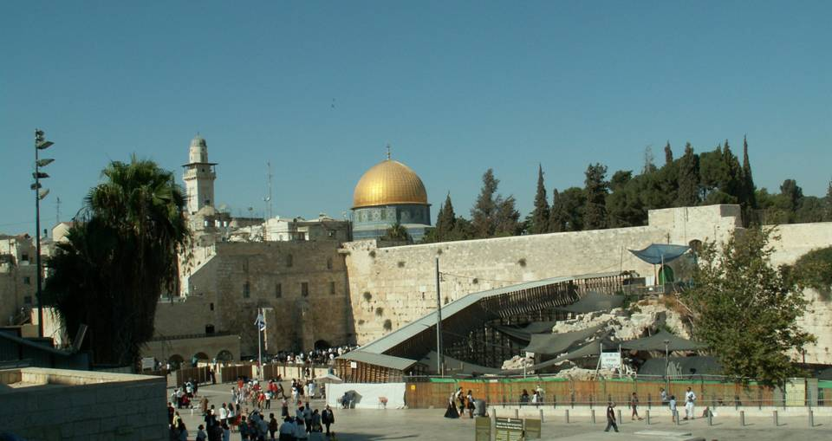
Jerusalem
Nevet Basker

Slide 2
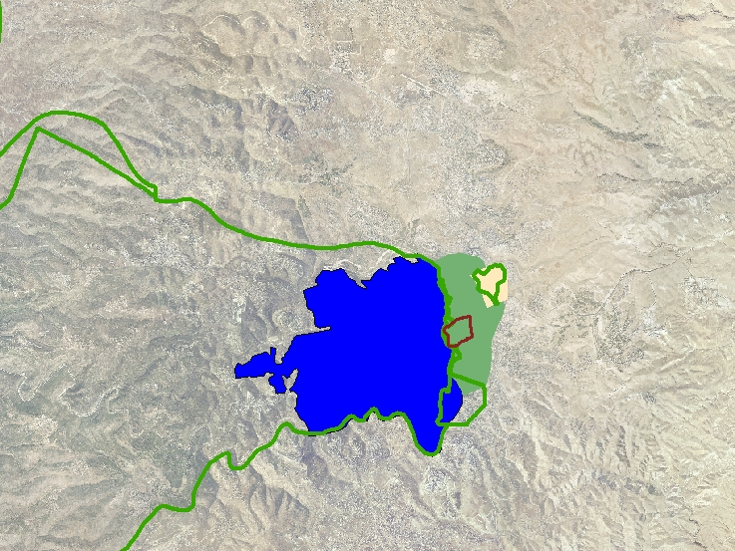
Pre-1967 Jerusalem
Israeli Jerusalem
9,500 Acres
150,000 Jews
Jordanian Jerusalem
1,500 Acres
9,000 Palestinians
The Old City
www.peacenow.org.il

Slide 3
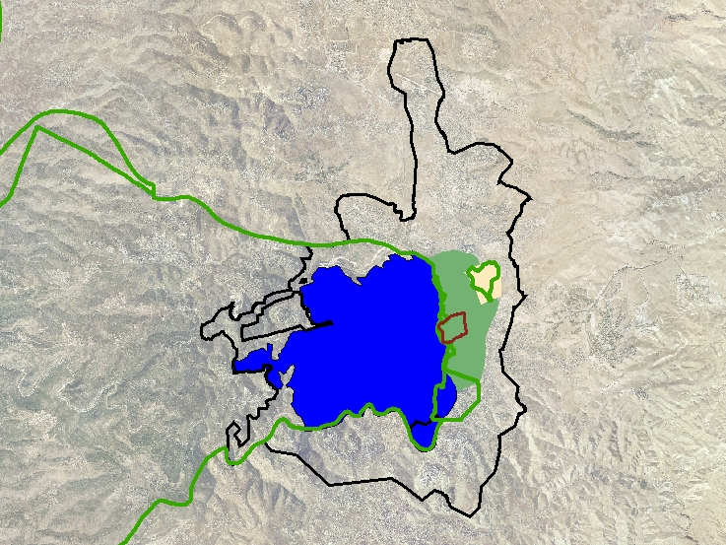
Post-1967 Jerusalem
A New Municipal Border
Following the 67 war, Israel annexed some 18,000 acres to Jerusalem, based on strategic and military considerations
www.peacenow.org.il

Slide 4
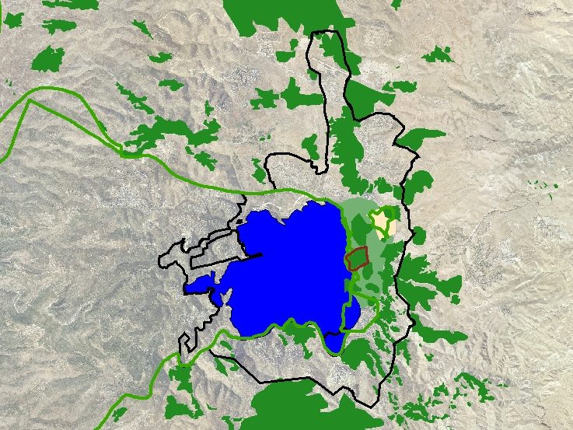
Ramallah
28 Arab villages were annexed to Jerusalem. Those Arabs got Israeli permanent residency and are eligible for full citizenship
Arab Neighborhoods
Jewish Neighborhoods
Municipal Border
Bethlehem
www.peacenow.org.il

Slide 5
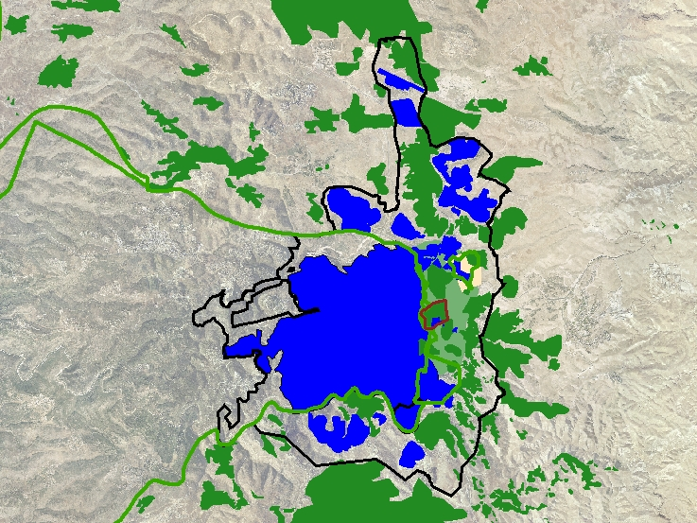
Ramallah
In 2010 there are 190,000 Israelis in East Jerusalem and over 250,000 Arabs.
Arab Neighborhoods
Jewish Neighborhoods
Municipal Border
Bethlehem
www.peacenow.org.il

Slide 6
Ramallah
Atatrot
Industrial Area
Neve Ya’acov
Pisgat Ze’ev
Rmot
Ramat Shlomo
The French Hill
Ramot Eshkol
East Talpiyot
Arab Neighborhoods
Jewish Neighborhoods
Gilo
Municipal Border
Har Homa
Bethlehem
www.peacenow.org.il

